Slide 1
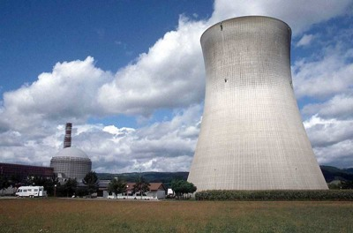
3.3 Energy Resources

Slide 2
Assignment
Your assignment is to create a poster that will compare and contrast two different sources of energy that humans use. One renewable and one non-renewable.
Be able to explain each energy source and how it works. Discuss the factors which affect why different societies would choose different energy sources.
Make sure to reference the rubric so that you know what you will be evaluated on.
Due Wednesday, February 24th

Slide 3
Types of energy resources
Renewable
Non-Renewable
Tidal
Solar
Wave
Wind
Geothermal
Hydroelectric
Radiant Energy
Biomass (biofuel/biogas)
Hydrogen Fuel Cells
Wood
Coal
Natural Gas
Oil (Petroleum)
Lignite
Compressed Natural Gas
Shale Oil
Tar Sand
Nuclear Power

Slide 4
Questions to be answered
What energy sources have you been assigned?
Where does the energy come from? (Materials)
How does each one of these generate energy? (Detailed process)
What are 2 advantages to using this source of energy?
What are 2 disadvantages to using this source of energy?
What factors affect the choice of energy sources by different societies? (availability, economic, cultural, environmental, technological)
Where is this energy source most commonly used? (MEDCs/LEDCs)
Pictures included
Neat, organized, and colorful

Slide 5
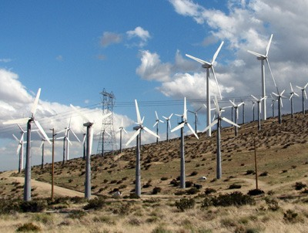

Slide 6
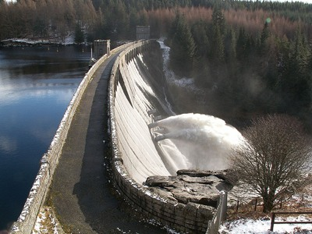
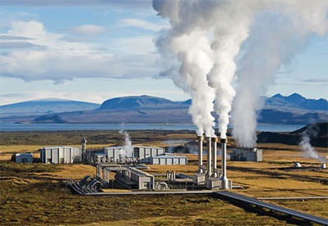
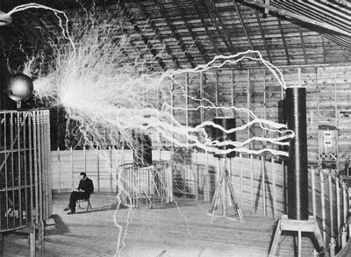

Slide 7
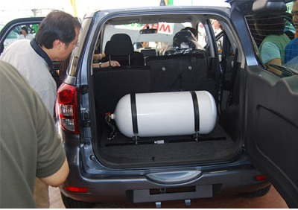
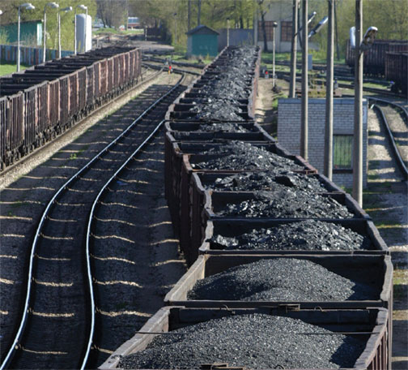
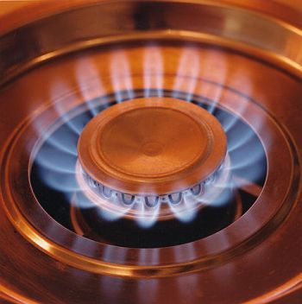

Slide 8
