Slide 1
4.3 Aquatic Food Production Systems

Slide 2
Significant Ideas
Aquatic systems provide a source of food production
Unsustainable use of aquatic ecosystems can lead to environmental degradation and collapse of wild fisheries
Aquaculture provides potential for increased food production
The demand for aquatic food resources continues to increase as human population grows and diet changes

Slide 3
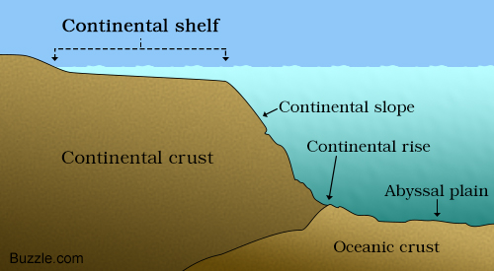
Continental Shelf
The extension of the continents under the sea and oceans
Creates shallow water
Width of shelf averages 80 km (50 miles)

Slide 4
Continental Shelf
Continental shelf is important because
Its has 50% of oceanic productivity
Upwellings bring nutrient rich water up to the shelf
Light reaches the shallow seas so producers can photosynthesize like phytoplankton
Single-celled phytoplankton which float in the sea are the most important producer in the oceans producing 99% of primary productivity
Single-celled zooplankton eat the phytoplankton and their waste (organic matter) which support complex food webs of the ocean

Slide 5
Continental Shelf & UNCLOS
Countries can claim continental shelves as theirs to exploit and harvest
UNCLOS: UN Convention on the Laws of the Seas
In 1982 designated continental shelves as belonging to the country from which they extend
Designated a 200 nautical mile (230 miles) limit from the shore outwards as an exclusive economic zone belonging to that country
Outside of that zone are international waters which no one country controls
This has a huge impact on fishing these areas
Who is allowed to fish there?
Who controls this?
Who cleans it up when there is a pollution problem
“Tragedy of the Commons”

Slide 6
Tragedy of the Commons
Read the Tragedy of the Commons (pages 221-222)
Take notes
Read To Think About: Collapse of the Newfoundland cod fishery (pages 220-221)
While reading, jot down anything that stood out to you or that you think is important
Be prepared for a class discussion
Complete the To Do reading and answer the questions on page 222

Slide 7
Fisheries
Aquatic (freshwater and marine) flora and fauna are harvested by humans
Wild fisheries are also known as “capture fisheries”
Fishery activity
90% in oceans & 10% in freshwater
Fisheries include
Shellfish: oysters, mussels, molluscs (including squid)
Some vertebrates: eels, tuna, etc.

Slide 8
Fisheries
According to the FAO (Food & Agriculture Organization) more than 70% of the world’s fisheries are exploited, in decline, depleted or too low to recover
Global fish catch is no longer increasing even though technology has improved
Demand is high but fisherman cannot find or catch enough fish
Developments in fishing equipment and changes to fishing methods have led to dwindling fish stocks and damage to habitats

Slide 9
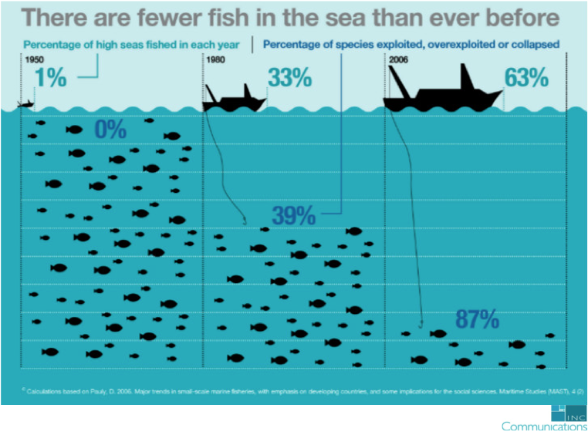

Slide 10
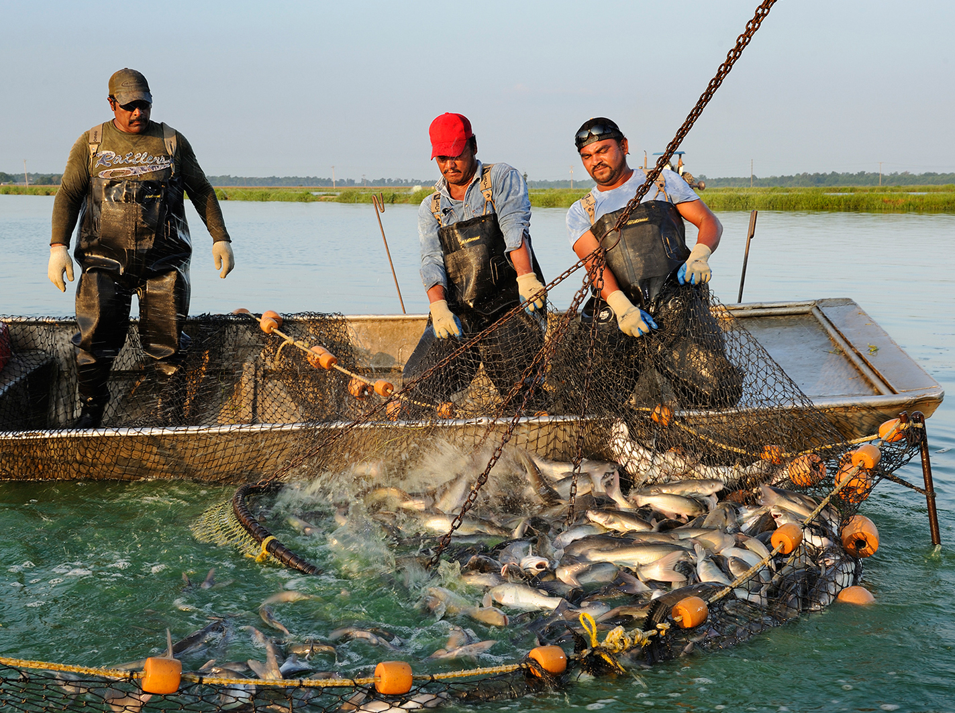
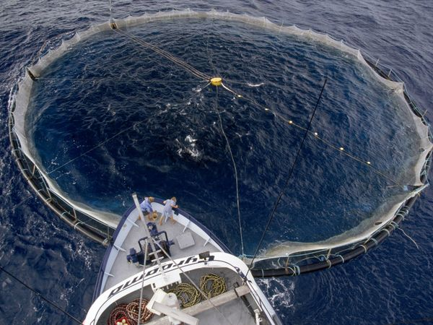
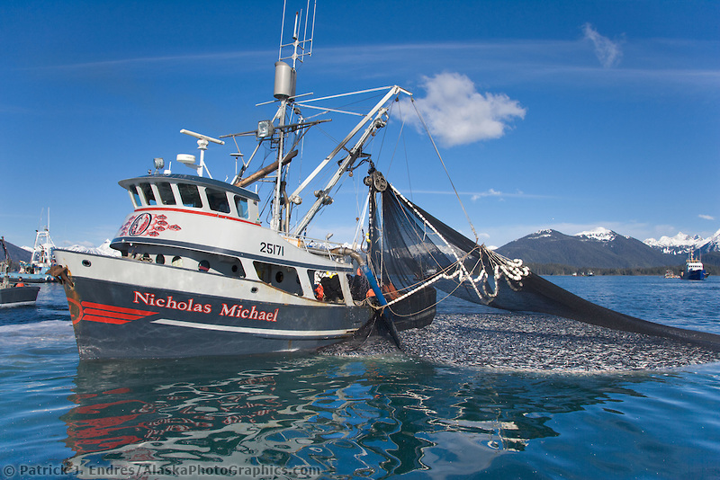
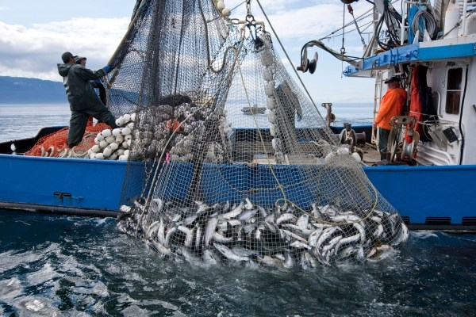
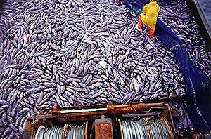
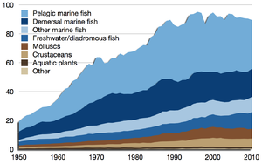
Unsustainable Wild Fishing Industry
We are so good at finding and catching fish that fish populations are being depleted very quickly
Once we catch larger specimens, we catch smaller and smaller ones and do not leave them to mature and reproduce
Commercial fishing uses satellite technology, GPS, and other fish finding scanning technology or military quality
Fishing fleets are larger with refrigeration techniques including blast freezing so that can stay at sea for weeks/season
Indiscriminate fishing gear will take all organisms in an area, whether they are target species or not
Trawlers drag huge nets over seabed virtually clearcutting it

Slide 11
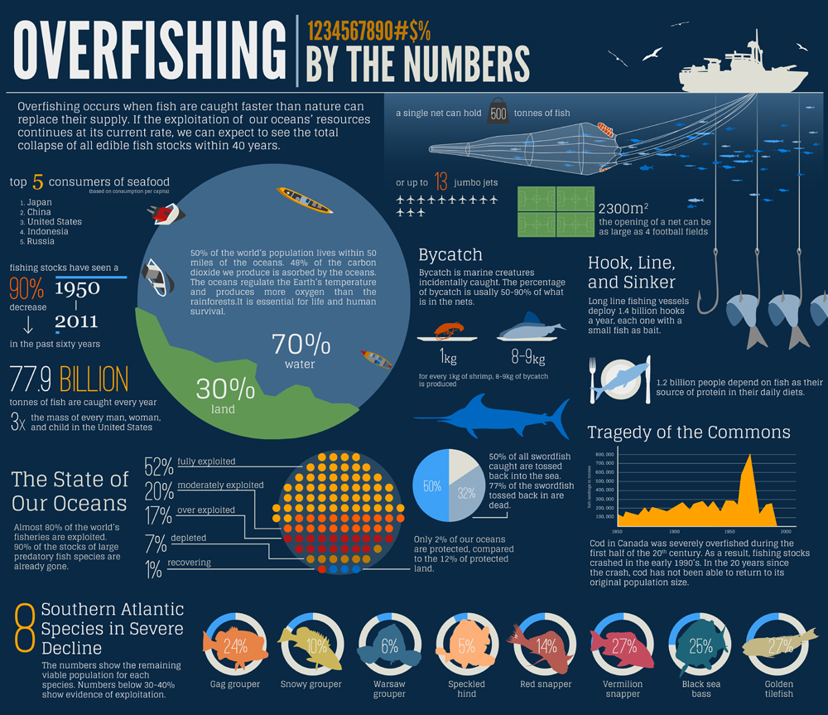

Slide 12
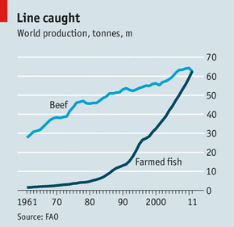
Fish Fad?
Human diets are changing
Many people in MEDCs are becoming more health conscious
Eating less meat from terrestrial animals like chicken and beef and eating more fish and vegetables
lowers saturated fat intake and cholesterol
Now, on average worldwide, each person eats about 44 pounds of fish and only 18 pounds of meat
Historically, higher for meat and lower for fish
Most extra fish comes from fish farms since wild caught fishing has reached its limit= aquaculture

Slide 13
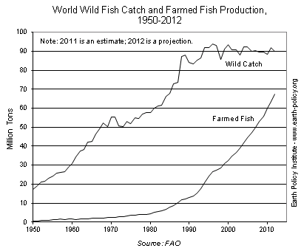
Aquaculture
Farming of aquatic organisms in both coastal and inland areas involving interventions in the rearing process to enhance production
We now eat more farmed fish than wild caught fish
However, we must make fish farming sustainable in order to meet demands
Fishmeal (fish food) uses more trimmings and scraps which would have been wasted in the past
Livestock and poultry processing waste is substituted for fishmeal
USDA have proven 8 species of carnivorous fish (white sea bass, walleye, rainbow trout, cobia, artic char, yellowtail, Atlantic salmon, coho salmon) can get enough nutrients from alternative sources without eating other fish

Slide 14
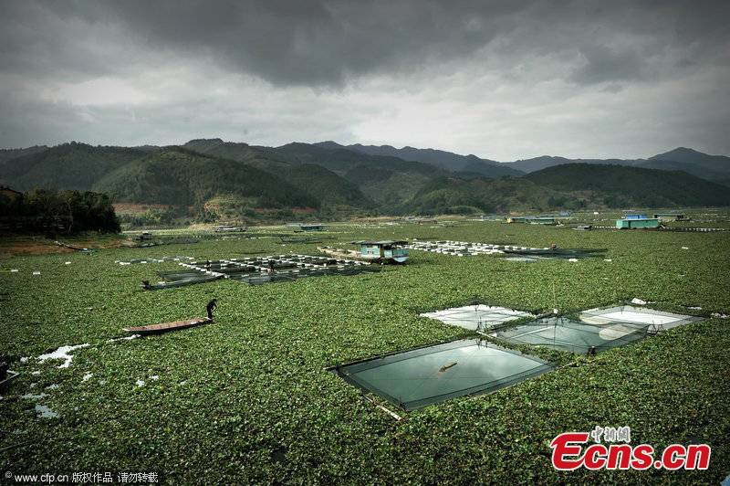
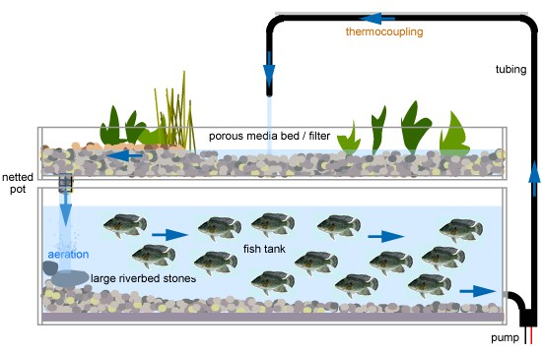
Aquaculture
China produces 62% of all farmed fish worldwide
Mostly carp or catfish
Fish are grown in rice paddies because their waste serves as a fertilizer for their rice
This system is used in many SE Asian countries

Slide 15
Aquaculture
Some aquaculture systems are less efficient
Shrimp and salmon are carnivores and are fed fishmeal or fish oil produced from wild fish
Mangrove swamps have been replaced by fish farms
Impacts of fish farms
Loss of habitats
Pollution with feed, antifouling agents, antibiotics and other medicines added to the fish pens
Spread of diseases
Escaped species including GMOs which may survive and interbreed with wild fish
Escaped species may outcompete native species = population crash

Slide 16
Classwork/Homework
To Do Questions page 218
To Do Questions on bottom of page 224
Research two contrasting fisheries
You may use one listed on page 225/To Do
Test on 2.4 (zonation & succession, not biomes) and all of Topic 4
A Day: March 14
B Day: March 13

Slide 17
IA Score Conversion

Slide 18
Warm Up
In a world committed to a free market, in a global context, have we the right to criticize or control those who use technology and labor efficiencies to produce more food at less cost? (Without intensive agriculture, we could not feed the human population)
What do we actually mean by ethical food?
Why does food harvesting/production need to be ethical?
What is Fairtrade? Does it help farmers out of poverty or does it make consumers in MEDCs feel better or both?

Slide 19
Sustainable Yield
Sustainable yield (SY) is the increase in natural capital or natural income that can be exploited each year without depleting the original stock or its potential for replenishment
For example: SY of an aquifer is the amount that can be taken each year without permanently decreasing the amount of water stored

Slide 20
Maximum Sustainable Yield
For commercial ventures, maximum SY is the highest amount that can be taken without permanently depleting the stock
In fisheries this is a crucial amount
How many fish and what size can be taken in any year so that the harvest is not impaired the following years
Dependent on the carrying capacity for each species which in turn depends on
Reproductive strategy
Longevity
Resources of the habitat/ecosystem

Slide 21
Maximum Sustainable Yield
Each breeding season/year, new individuals enter the population (births and immigration)
If the number recruited is larger than the number leaving (dying or emigrating) = net increase
If difference in population from initial size to new size is harvested the population remains the same = maximum sustainable yield (MSY)
SY = annual growth/recruitment – annual death/emigration

Slide 22
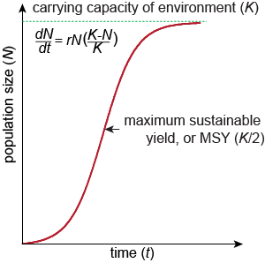

Slide 23
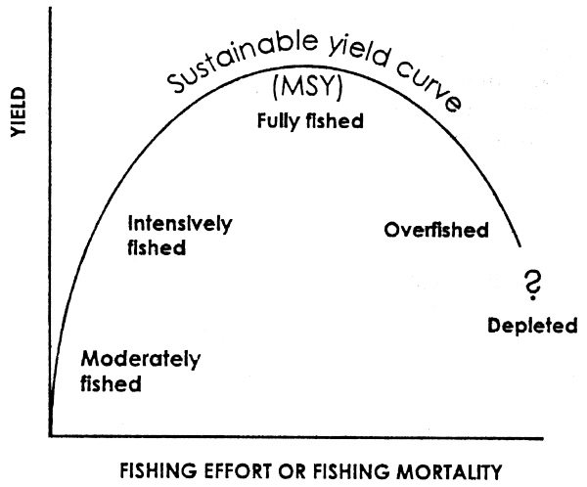

Slide 24
Maximum Sustainable Yield
Harvesting MSY normally leads to population decline and thus loss of resource base and an unsustainable industry or fishery
Population dynamics are normally predicted/estimations rather than the species numbers being counted
Impossible to be precise about the size of a population (think back to Lincoln Index: capture, tag, release, recapture)
Estimates are made on previous experience
Does not monitor the dynamics of the harvest in terms of age and sex ratio
For ex: if more females caught than this will have a much greater impact on future growth of population as will targeting young immature fish
Disease may strike the population

Slide 25
Optimal Sustainable Yield
Requires less effort than a MSY
Maximizes the difference between total revenue and total cost
Fishing quotas are often set as a percentage o proportion of the OSY per fleet per year
Set as a weight of catch not number of fish

Slide 26
Ethics and Harvesting
Some cultures harvest species such as seals and whales which is quite controversial
Historical Inuit tradition of whaling
Ethical?
Ethical issues arise over biorights
Conflict of rights of indigenous cultures and international conservation legislation

Slide 27
Whaling: A Way of Life?
The Inuit are indigenous aboriginal people of Northern Canada
Rely heavily on fishing and hunting as main source of food and income
Hunt whales, seals, polar bears, walrus, caribou, muskoxen, birds, Arctic fox, and fish
Under the terms of the 1986 moratorium on whaling, the International Whaling Commission allows whaling carried out by aboriginal groups if it occurs on a subsistence basis, known as Aboriginal Subsistence Whaling
Subsistence: small scale, low technology, for individual household, not commercial
Whaling of this type is restricted to native peoples and others working on their behalf, as defined by the International Whaling Commission

Slide 28
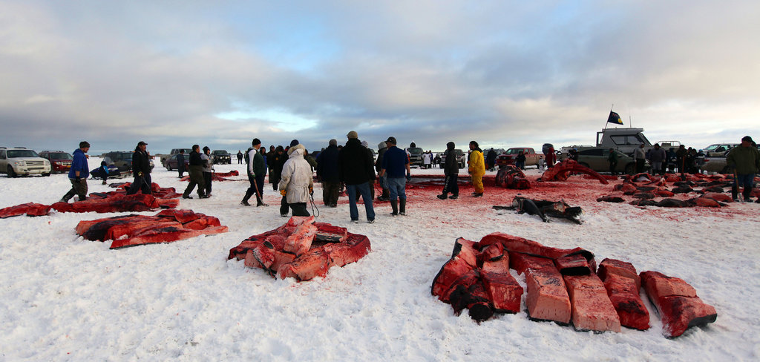
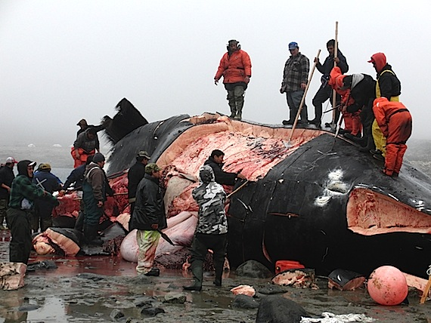
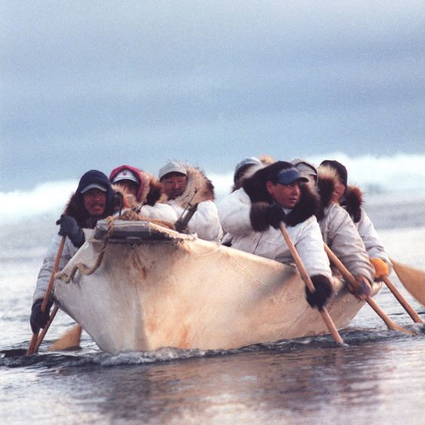
https://www.youtube.com/watch?v=QrH0S68-luc
https://www.youtube.com/watch?v=_tqW8YZDE9o

Slide 29
TOK
To what extent does our culture determine or shape our ethical judgement?

Slide 30
Exam-style Question

Slide 31
Classwork/Homework
To Do Questions page 218 & To Do Questions bottom of page 224
Research two contrasting fisheries
You may use one listed on page 225/To Do
Marine Stewardship Council
https://www.msc.org/documents/environmental-benefits/measuring-environmental-impacts-report-2011/fishery-case-studies
A Day: March 14
B Day: March 13
Test on 2.4 (zonation & succession, NOT biomes) and all of Topic 4
A Day: March 14
B Day: March 13
Water Treatment Plant Assignment
A Day: March 20
B Day: March 21

Slide 32
