Slide 1
Topic 5: soil & terrestrial food production systems
5.1 Introduction to soil systems

Slide 2
What is soil?
Complex ecosystem made up of minerals, organic matter, organisms, nutrients, air, gases and water
We tend to take soil for around us for granted but it is more than just mud or dirt:
Food we eat depends on soil
Plants grow in soil
Habitat for many organisms
Holds water and mineral nutrients that plants depend on
Filters any water that passes through it
Stores and transfers heat which affects atmospheric temperature
Part of the lithosphere where life processes take place

Slide 3
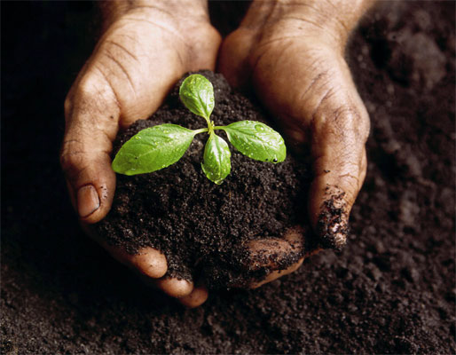
What is soil made from?
4 main components:
Mineral particles mainly from underlying rock
Organic remains that have come from the plants and animals
Water within spaces between soil grains
Air also within the soil grains

Slide 4
Soil composition by percent

Slide 5
Soil storages
Organic matter
Organisms
Nutrients
Minerals
Air
Water

Slide 6
Transfers & transformations in soil systems
Transfers
Biological mixing and leaching (minerals dissolved in water moving through the soil)
Transformations
Decomposition
Weathering
Nutrient cycling

Slide 7
Inputs & Outputs in soil systems
Inputs
Organic material including leaf litter
Inorganic material from parent material
Precipitation
Energy
Outputs
Uptake by plants
Soil erosion

Slide 8
Factors in Soil Development
Parent Material: The rock or minerals from which the soil derives. The nature of the parent rock can either be native to the area or transported Has a direct effect on the ultimate soil profile.
Climate: results in partial weathering of parent material, which forms the substrate for soil.
Living Organisms: include nitrogen-fixing bacteria, Rhizobium, fungi, insects, worms, snails etc. that help decompose litter and recycle nutrients.
Topography: the physical characteristics of the location when the soil is formed
drainage
slope direction
elevation
wind exposure

Slide 9
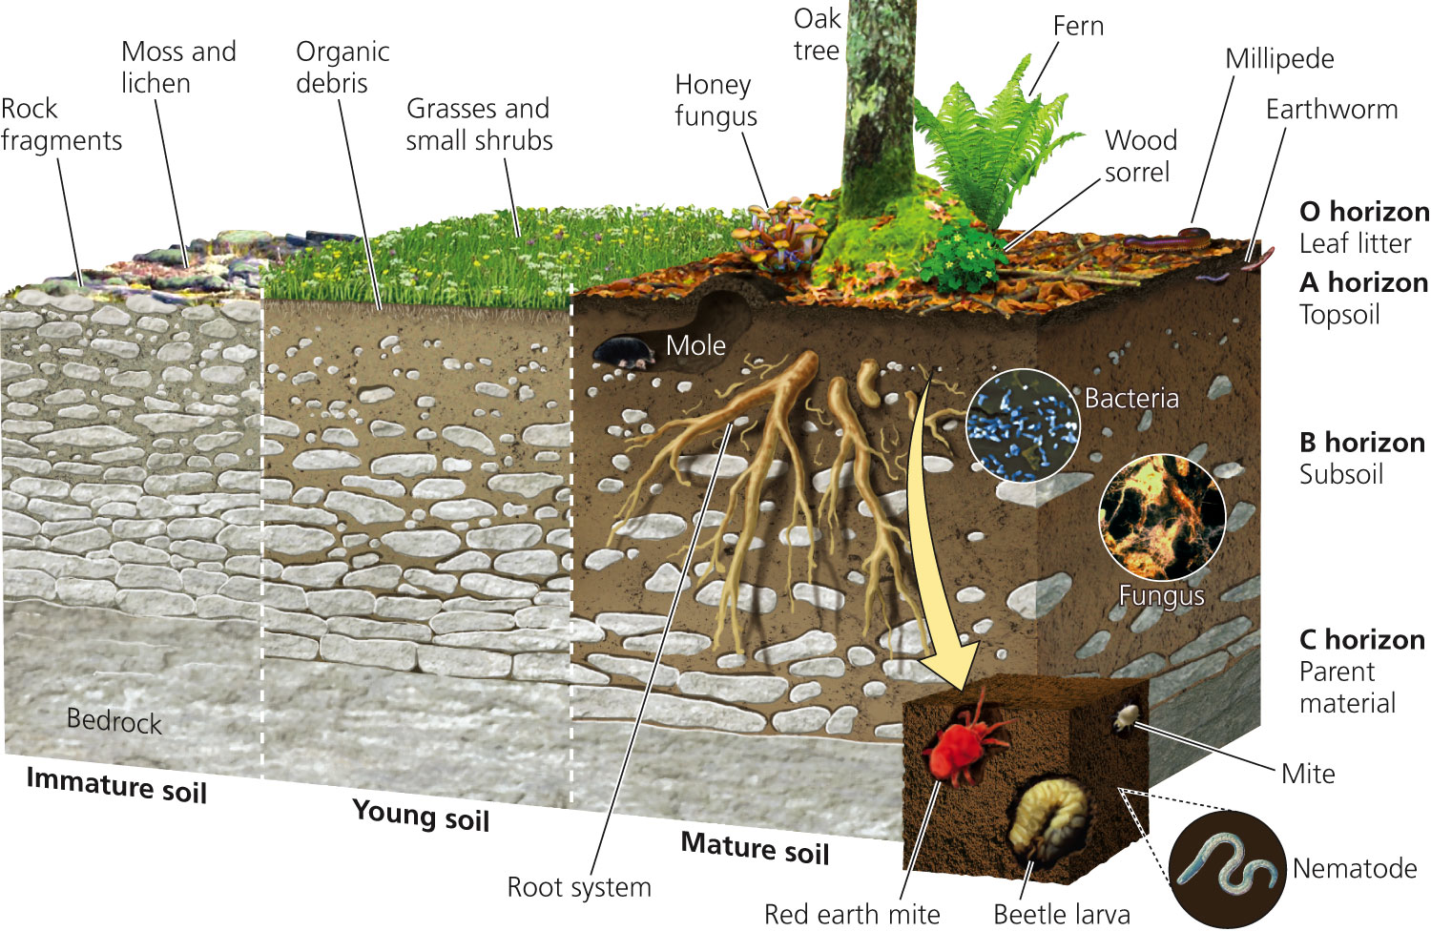
Soil Formation Over Time

Slide 10
Weathering and Soil
3 Types of weathering
Physical weathering (mechanical weathering) – process that breaks rock down into smaller pieces without changing the chemistry of the rock. The forces responsible for it include wind and water.
Chemical Weathering – occurs as a result of chemical reactions between water and other atmospheric gases, and the bedrock in a region.
Biological Weathering – takes place as a result of the activities of living organisms.

Slide 11
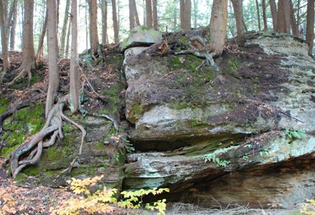
Three Processes of Soil Formation
Very slow process cause by weathering
1. Weathering of rock (mechanical)
2. Deposition of sediments by erosion (mechanical)
3. Decomposition of organic matter (chemical/biological)

Slide 12
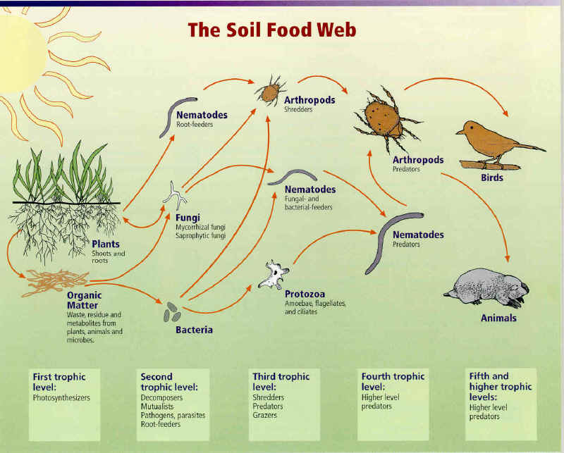
Soil System Food Web

Slide 13
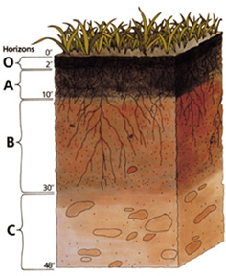
Soil horizons (layers)
O - (Organic) Freshly fallen leaves/leaf litter, twigs, animal waste, fungi
A- Mineral horizon
E- (not shown) subsurface horizon mixture of partially decomposed organic matter, clay, iron, and aluminum compounds
B- (Subsoil) Nutrients leached from A “Plant Roots”, enrichment of clay material, iron, aluminum, or organic compounds
C- (Parent Material) largely inorganic material, loosened, unconsolidated material
R- (not shown) hard bedrock

Slide 15
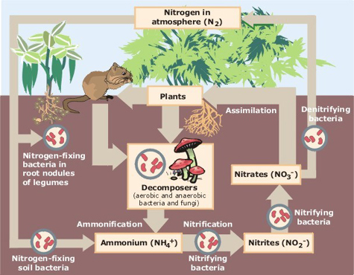
Nitrogen Cycle

Slide 16
Nitrogen Cycle Terms
Nitrogen Fixation: Atmospheric nitrogen (N₂) is made available to plants
Nitrification: Bacteria in soil convert ammonium (NH₃) to nitrite(NO₂) and then nitrates (NO₃).
Denitrification: Bacteria in soil nitrates (NO₃) to nitrogen gas (N₂)
Assimilation: Living organisms take in the nitrogen to make proteins
Ammonification: Bacteria and fungi decompose waste and organisms and allow for ammonia to be released into the soil

Slide 17
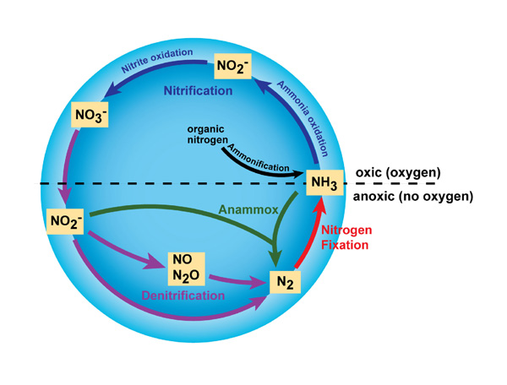
Processes in the Nitrogen Cycle

Slide 18
Soil texture & structure
Soil Texture is determined by the relative amounts of the different types and sizes of mineral particles
Clay (very fine particles <0.002mm)
Silt (fine particles 0.05mm-0.002)
Sand (medium-sized particles 2mm-0.05mm)
Gravel (large coarse particles > 2mm)
Smallest
Largest

Slide 19
Soil Component Description
COMPONENT DESCRIPTION
Clay Very fine particles. Compacts easily. Forms large, dense clumps when wet. Low permeability to water; therefore, upper layers become water logged.
Gravel Coarse particles. Consists of rock fragments.
Loam About equal mixtures of clay, sand, silt and humus. Rich in nutrients. Holds water but does not become waterlogged.
Sand Sedimentary material coarser than silt. Water flows through too quickly for most crops. Good for crops and plants requiring low amounts of water.
Silt Sedimentary material consisting of very fine particles between the size of sand and clay. Easily transported by water.

Slide 20
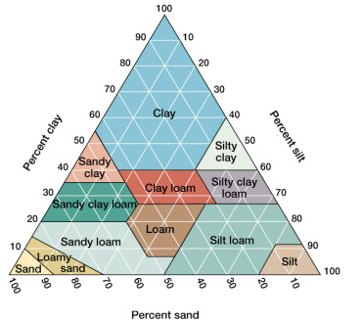
Soil Texture Triangle

Slide 21
Soil Practice Problems
1. Sand = 25 % Silt = 15 % Clay = 60 %
2. Sand = 30 % Silt = 35 %
Clay = 35 %
3. Sand = ? Silt = 10 % Clay = 40 %

Slide 22
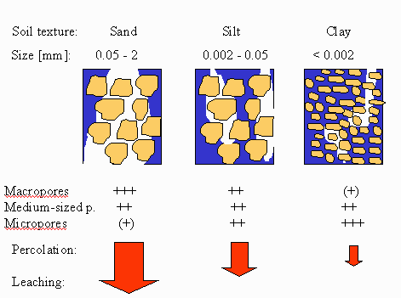
Soil Permeability
Rate at which air and water flow from upper layers
of soil to lower layers of soil

Slide 23
Soil Texture | Nutrient Capacity | Infiltration | Water Holding Capacity | Aeration | Workability
Clay | Good | Poor | Good | Poor | Poor
Silt | Medium | Medium | Medium | Medium | Medium
Sand | Poor | Good | Poor | Good | Good

Slide 24
Primary Production & Soil
Primary production of soil depends on the following factors:
mineral content
drainage
water-holding capacity
airspaces
organisms present
potential to hold organic materials

Slide 25
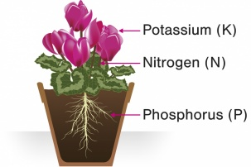
Nitrates, Phosphates, Potassium (NPK)
Main nutrients found in soil
Leached out of soil or removed when a crop is harvested
Replaced via chemical fertilizers, growing legumes, crop rotation, or through the application of organic matter (manure, compost)

Slide 26
pH & Soil
Most soils fall into the pH range of 4-8
pH affects the solubility of nutrients which determines the extent to which these nutrients are available for absorption by plant roots.
If the soil is too basic or too acidic, certain soil nutrients will not be able to be used by regional plants.

Slide 27
Acidification of Soil
Major impact on forestry in Northern Europe where acid rain caused by industrial pollution has the made the soil more acidic
More available aluminum and iron ions in the soil causing damage to evergreen forestry through needle death

