Slide 1
Topic 5.5 Solid Domestic Waste

Slide 2
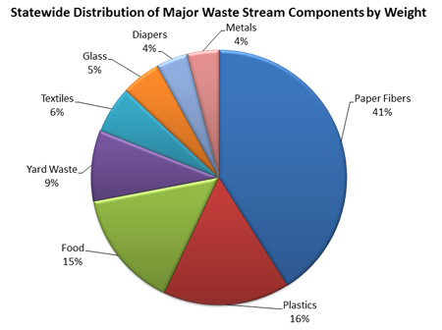

Slide 3
Waste Overview
Domestic solid waste, commonly known as trash or garbage (US), refuse or rubbish(UK) is a waste type consisting of everyday items that are discarded by the public. The organic waste potions consist of food and kitchen waste, yard trimmings or other garden waste. Inorganic waste consists of paper, corrugated cardboard, plastic, glass, wood, and metal products such as drink cans.

Slide 5
http://www.cbsnews.com/videos/the-wasteland-50076351/

Slide 6
http://www.youtube.com/watch?v=6eXRfynD-M8

Slide 7
http://www.youtube.com/watch?v=VhJRuiEld9Y

