Slide 1
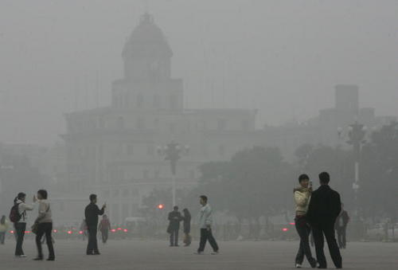
6.3 Photochemical smog

Slide 2
Primary Pollutants
Combustion of fossil fuels
Carbon monoxide
Carbon dioxide
Black carbon/soot
Unburned hydrocarbons
Oxides of nitrogen
Oxides of sulfur

Slide 3
Secondary Pollutants
In the presence of sunlight, primary pollutants undergo reactions with other chemicals present in the atmosphere = secondary pollutants are created
Tropospheric ozone: bad ozone

Slide 4
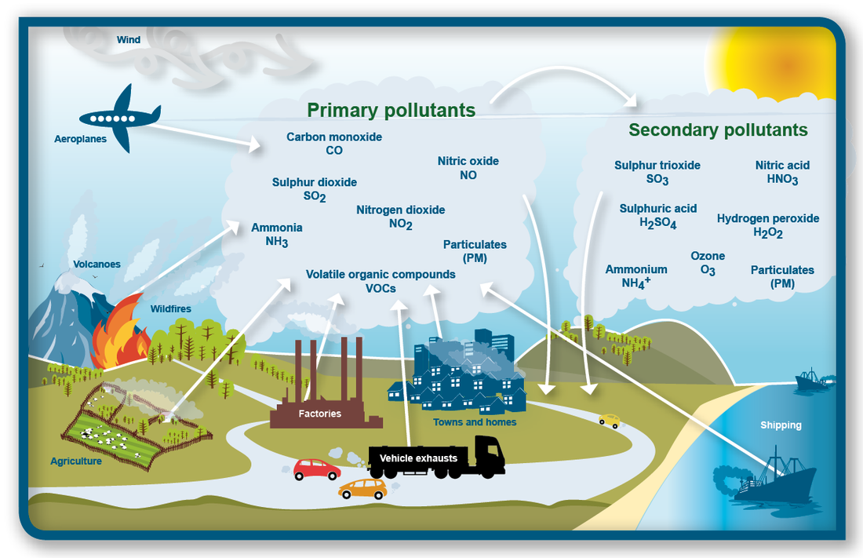
Primary vs Secondary Pollutants

Slide 5
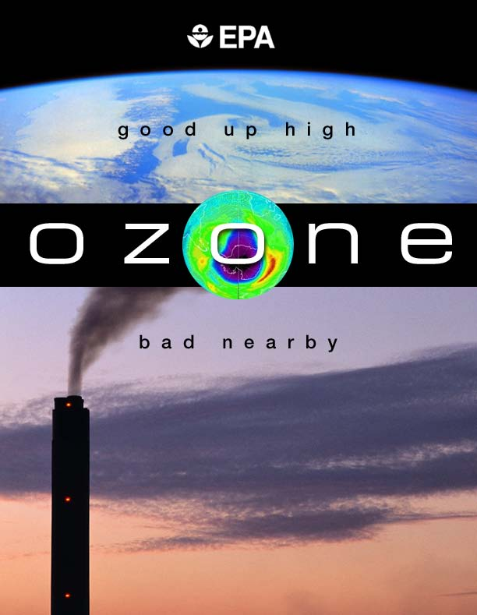

Slide 6
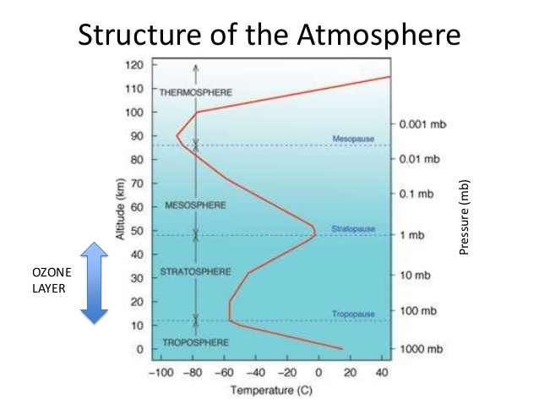

Slide 7
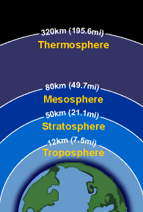
Tropospheric Ozone (Bad Ozone)
Secondary pollutant
Tropospheric ozone (ground level ozone) = bad ozone (not protective) as a result of human activity
Sources:
Formed when oxygen molecules react with oxygen atoms that are released from nitrogen dioxide in the presence of sunlight
Burning of fossil fuels→ hydrocarbons and Nitric oxides→ sunlight and NO₂ → formation of 0₃ (page 289)

Slide 8
Tropospheric Ozone (Bad Ozone)
Problems:
Ozone absorbed by plant leaves degrades chlorophyll so productivity is reduced
Damages crops, forests
Irritates eyes
Creates respiratory illnesses
Degrades many textiles, fabrics, and rubbers (think of an old rubber band!)
Smog: complex mixture of primary and secondary pollutants; main pollutant in tropospheric ozone

Slide 9
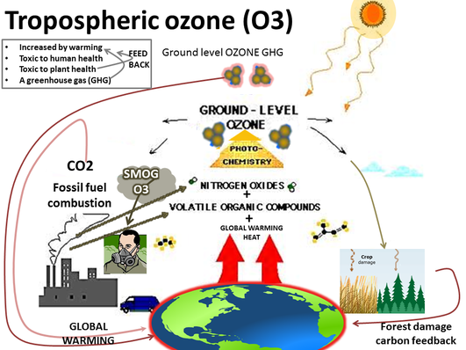

Slide 10
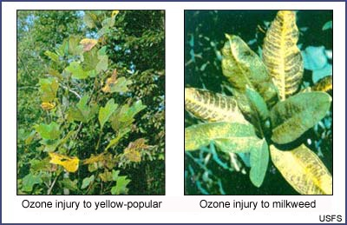
Damage from Tropospheric Ozone

Slide 11
Photochemical Smog
Smog is often seen as a brown haze above a large city
Frequency and severity depends on local topography, climate, population density, fossil fuel use
Thermal inversions occur due to lack of air movement when a layer of cool dense air is trapped beneath a layer of less dense, warm air
Concentrations of air pollutants build up near the ground instead of being dissipated by “normal” air movement
Deforestation and burning may also contribute to smog
Economic losses caused by urban air pollution can be significant
Toxic gas leads to breathing difficulties and health problems such as cancer

Slide 12
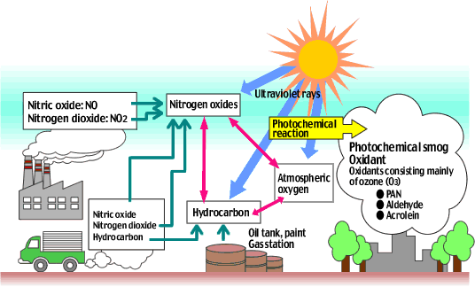
Formation of Photochemical Smog

Slide 13
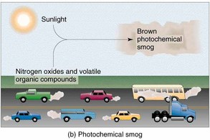
Formation of Photochemical Smog

Slide 14
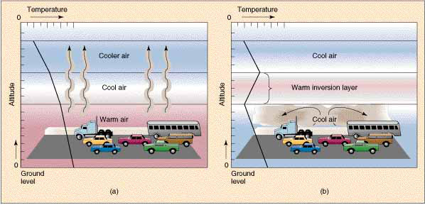
Thermal Inversions

Slide 15
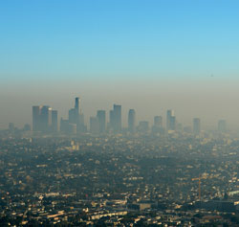
Smog Pollution in LA

Slide 16
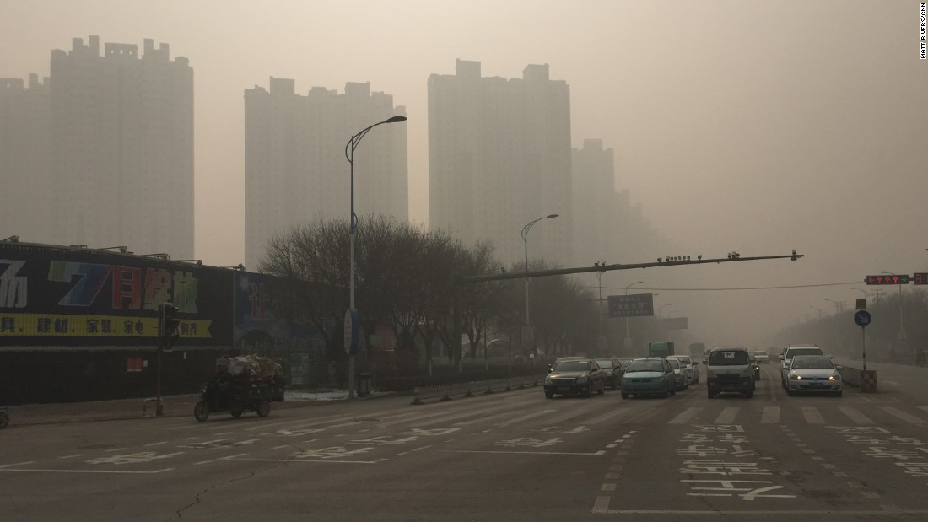
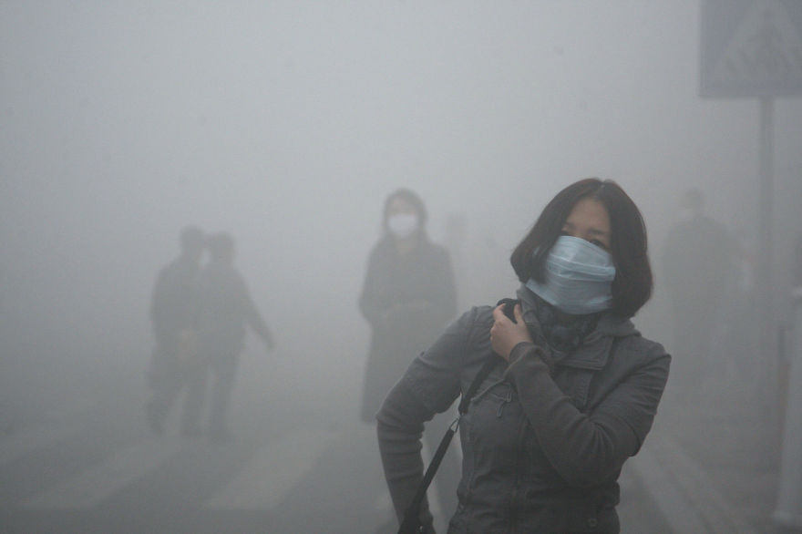
Smog Pollution in China

Slide 17
Pollution Management Strategies
Alter human activity
Consume less fossil fuels
Purchase energy efficient technology
Use public or shared transit
Walk, cycle, carpool
Regulate and reduce pollutants
Government regulation or taxation
Use catalytic converters to clean the exhaust of primary pollutants from cars
Regulate fuel quality
Restoration & Clean-Up
Reforestation
Regreening (more trees, more parks = absorb CO2)

Slide 18
Air Pollution Investigation
Carbon Dioxide Analysis
As a class we will go outside and count cars for 15 minutes (must convert this to cars/hour)
Number counted X 4 = cars/hour
Work in groups of 4
One person counts cars
One person counts trucks
One person counts buses
One person counts 18 wheelers
Share data with each other to perform calculations and answer questions based on the data collected

Slide 19
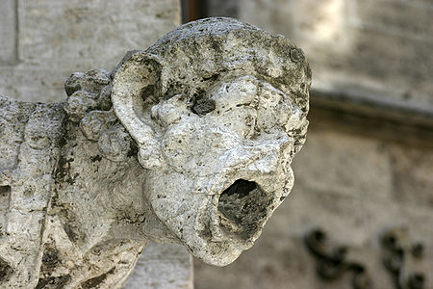
6.4 Acid deposition

Slide 20
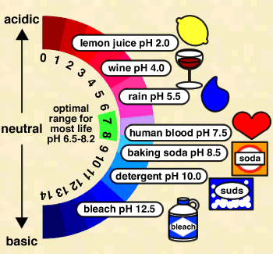
pH Scale

Slide 21
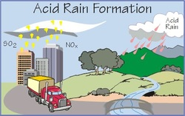
Acid Deposition
General term for acid coming down from the air
Combustion of fossil fuels produces sulfur dioxide and nitrogen oxide as primary pollutants
Gases converted into secondary pollutants
Acid rain or snow = wet deposition
Ash or dry particles = dry deposition

Slide 22
Acid Deposition
Pollutants:
Primary: those directly emitted by a factory or automobile
SO₂ - sulfur dioxide
NO and NO₂, usually identified as NO_{x}
Secondary: primary pollutants react with other substances in the atmosphere and create different pollutants
H₂SO₃ - sulfurous acid
H₂SO₄ - sulfuric acid
HNO₃ - nitric acid

Slide 23
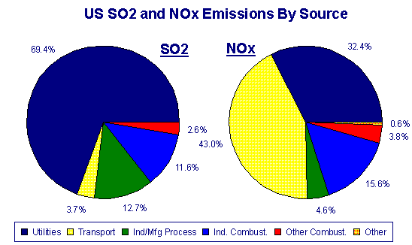
Primary Pollutants by Source

Slide 24
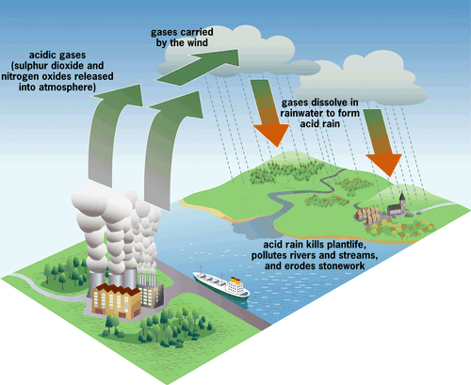
Acid Deposition (Process)

Slide 25
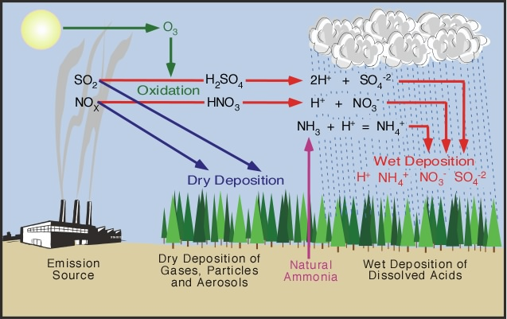

Slide 26
Effects of Acid Deposition
Soil, water, and living organisms are all effected
Direct effect
Acid on aquatic organisms and coniferous forests
Indirect toxic effect
Increased solubility of metals such as aluminum ions on fish
Indirect nutrient effect
Leaching of plant nutrients

Slide 27
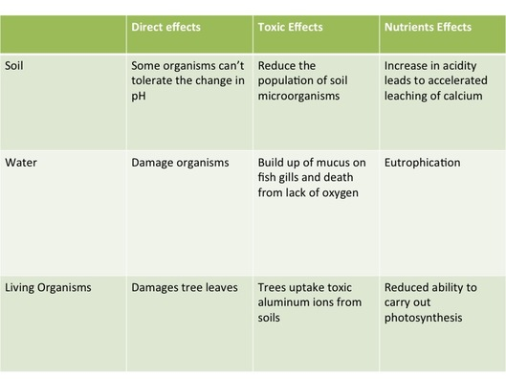
Effects of Acid Deposition

Slide 28
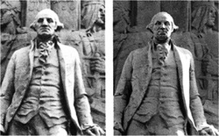
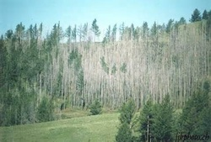
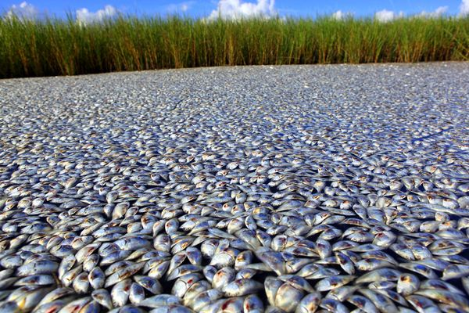

Slide 29
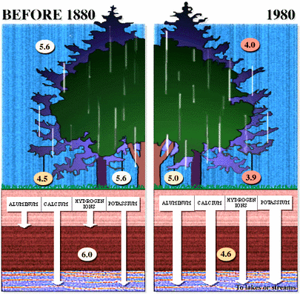

Slide 30
Effects of Acid Deposition
Acid deposition is regional, not global!
Impacts of AD may be limited to areas downwind of major industrial regions
These areas may not be in the same country as the source of emissions
Canadian forests damaged by coal-fired power plants in USA
Scandinavian and German forests damaged by British coal plants

Slide 31
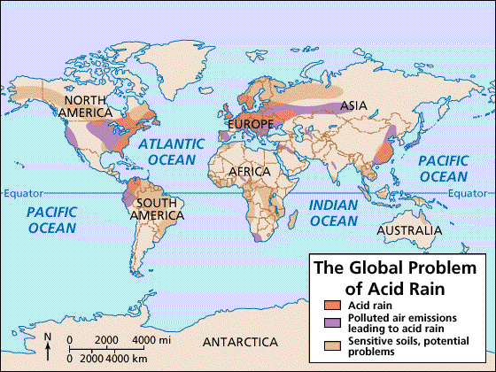

Slide 32
Effects of Acid Deposition
https://www.youtube.com/watch?v=Rnu5aLhZMdA&x-yt-ts=1422327029&x-yt-cl=84838260

Slide 33
Pollution Management Strategies
Alter human activity
Reducing use or using alternatives to fossil fuels
Regulate and reduce
International agreements and national governments may work to reduce pollutant production through lobbying
Monitor the release of pollutants
Scrubbers in smoke stacks may remove sulfur dioxide from coal-burning power plants
Clean up and restoration
Spreading ground limestone in acidified lakes
Recolonization of damaged systems

Slide 34
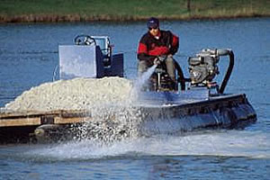
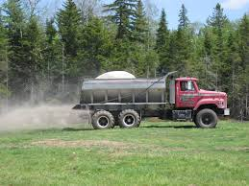
Liming

Slide 35
Classwork
Take notes on 6.4: Acid Deposition
To Do Question page 297
Choose one of the areas to research
Canada
http://www.kwanga.net/chemnotes/case-study-2.pdf
Sweden
https://www.greenleft.org.au/content/swedish-forests-threatened-acid-rain
China
http://www.geocases2.co.uk/acidrain3.htm
Write down your findings, include the following:
Effect of acid deposition
Intergovernmental agreements or legislation
Effectiveness/evaluation
Create a mini-poster as a public service announcement outlining the impacts of acid deposition and pollution management strategies
Take notes on Topic 7 (Spring Break Assignment)

Slide 36
Ocean Acidification
https://www.youtube.com/watch?v=5cqCvcX7buo&x-yt-cl=84838260&x-yt-ts=1422327029

