Slide 1
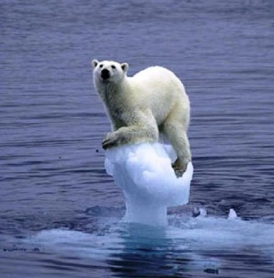
Topic 7.2 Climate Change - causes & impacts

Slide 2
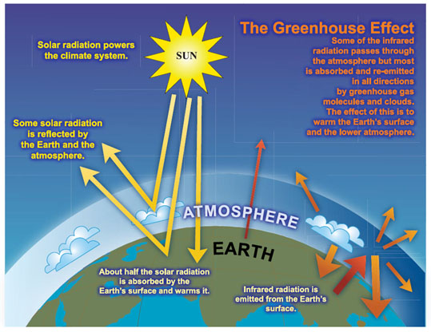
What is the Greenhouse Effect?
Greenhouse gases in the atmosphere trap the heat and radiation given off by the Earth’s surface
Global temperature is a result of absorbed sunlight

Slide 3
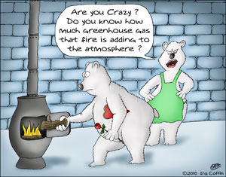
Greenhouse gases (GHG’s)
Gases are in order from most to least abundant in the atmosphere
Water Vapor
Carbon Dioxide
Methane
Nitrous Oxide (N₂O)
CFC’s (Chlorofluorocarbons)
You are responsible for knowing sources due to human activity for each of these gases!

Slide 4
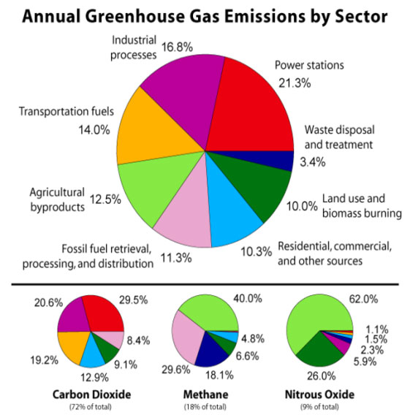
Annual Greenhouse gas emission by sector

Slide 5
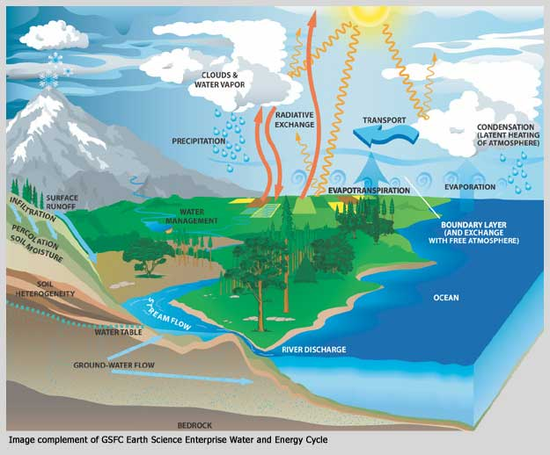
Water Vapor (H₂0)
Most Abundant greenhouse gas
Positive Feedback Cycle
Higher temps
More heat
trapped
Increased
evaporation
More H20
Vapor in
atmosphere

Slide 6
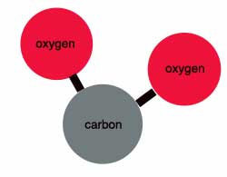
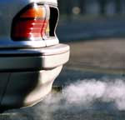
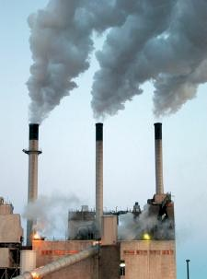
Carbon Dioxide (CO₂)
Present naturally
Average lifetime weeks to thousands of years
Increased since industrial revolution
Combustion of fossil fuels (coal, natural gas, petroleum)
For every kg of fossil fuel burned 3kg of CO₂ released
Deforestation
Fewer forests = less absorption of CO₂ from atmosphere

Slide 7
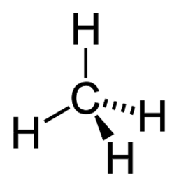
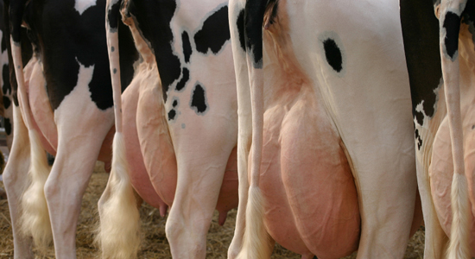
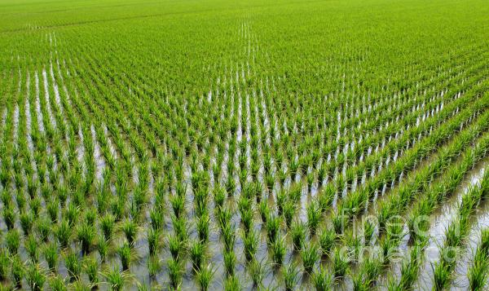
Methane (CH₄)
Absorbs 20-30x more heat than CO₂
Avg. lifetime 12 years in atmosphere
Sources
Landfills
Rice Paddies
Agriculture
Coal mines and natural gas

Slide 8
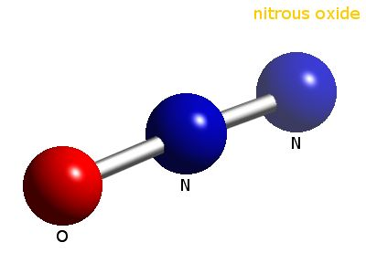
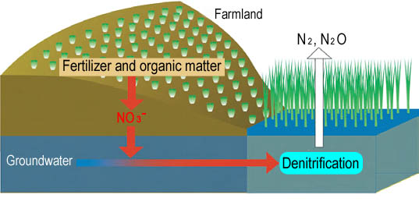
Nitrous Oxide (N₂O)
Agricultural Source
Result of a natural process, in the nitrogen cycle
Enhanced by nitrogen containing fertilizers
Avg. Lifetime 114 years in atmosphere
Industrial Source
High temperature combustion of fossil fuels

Slide 9
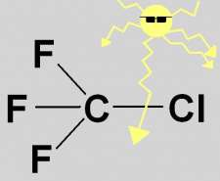
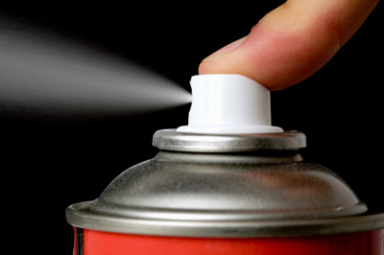
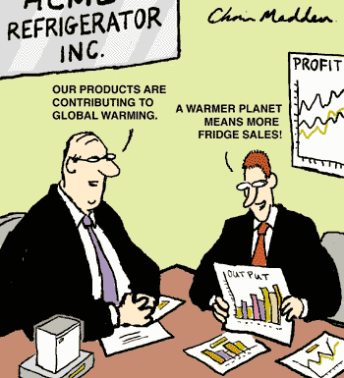
CFC’s and Halocarbons
Problems
Depletes the ozone
Banned in 1987 Montreal Protocol
Avg. lifetime weeks-thousands
of years in atmosphere
Absorb more than 10,000x
heat of CO₂
Sources
Foam
Cleaners
Aerosol sprays
Refrigeration and air conditioning coolants

Slide 10
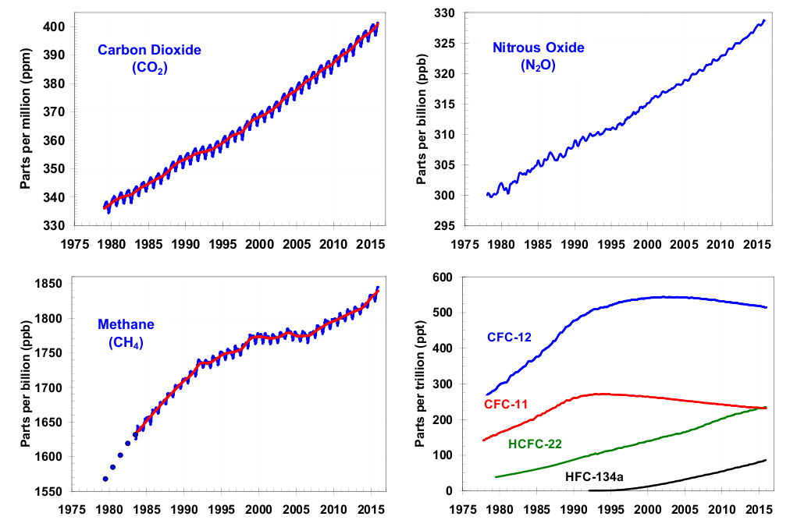

Slide 11
Climate Change and GHGs
There are 5 ways in which climate can change over time due to a change in GHG levels
Direct relationship – more forcing, more change in proportion
Buffering action – forcing increases but climate change does not follow; insensitive to change
Accelerate – respond slowly at first, but then reach a new equilibrium
Tipping point – climate makes no response to changes but then reaches a threshold at which point it changes rapidly until a new equilibrium is reached
Stuck at new equilibrium – even when forcing decreases until it tips over a new threshold and falls rapidly; changes could occur in just a few decades

Slide 12
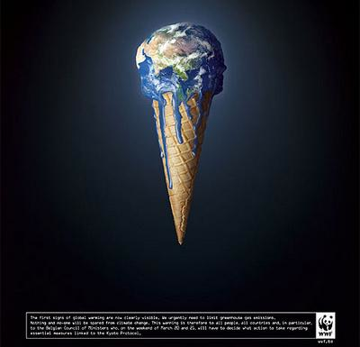
Effects of Climate Change
Sea levels may rise causing floods
Ocean absorb CO₂ – may become more acidic
Polar ice caps melt
Eliminating unique habitat from earth
More heat = more energy in climate and can lead to more violent storms
Changing climate may shift biomes- loss of habitat and changing where food is grown
Force animals to migrate
Loss of biodiversity
Negative effects human health
Deadly heatwaves, spread of diseases
Decreased water supplies
Increased evaporation rates

Slide 13
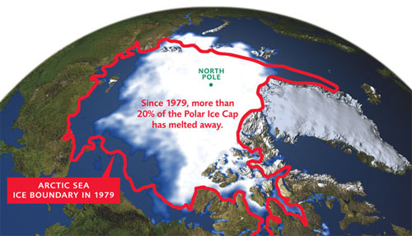
Melting Ice Caps

Slide 14
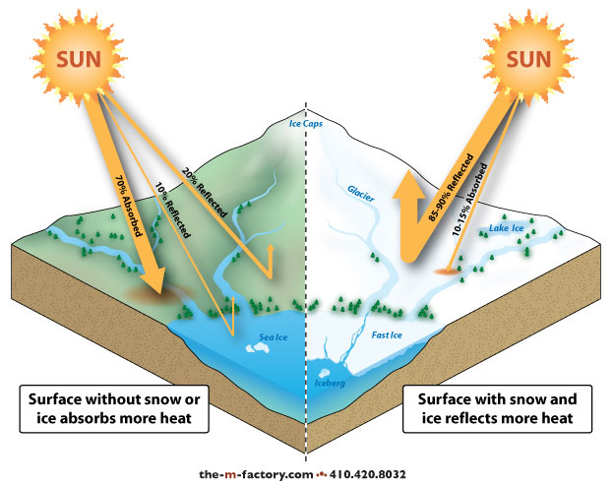
Albedo: Sunlight that hits a surface and is reflected away from the Earth (usually white surface like icecaps & glaciers)

Slide 15
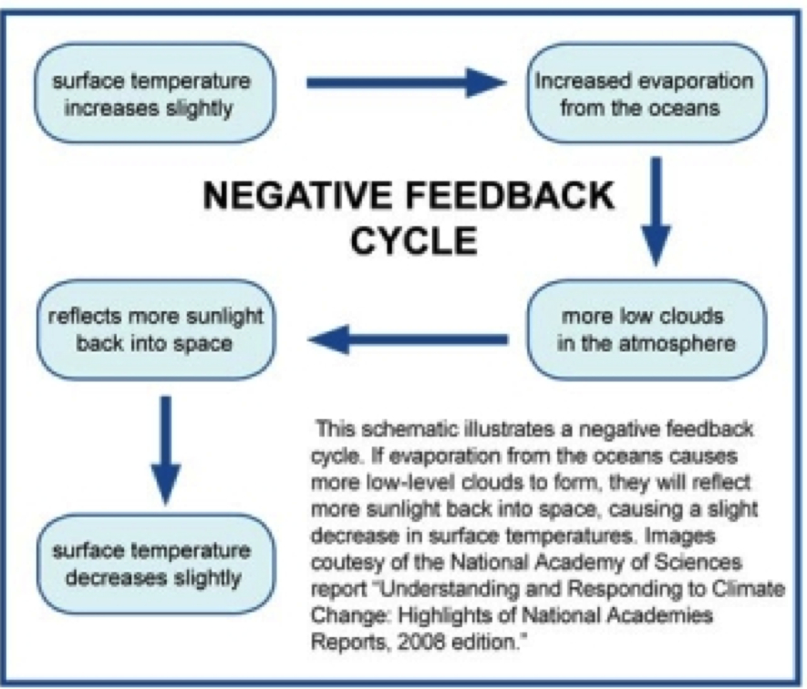
Feedback Mechanisms of Climate Change
Negative feedback: warming temperatures → Increased evaporation → increased cloud cover→ increasing albedo effect → decreased temperatures

Slide 16
Feedback Mechanisms of Climate Change
Positive feedback: warming temperatures→ more evaporation→ more clouds→ more water vapor which traps heat → increased temperatures

Slide 17
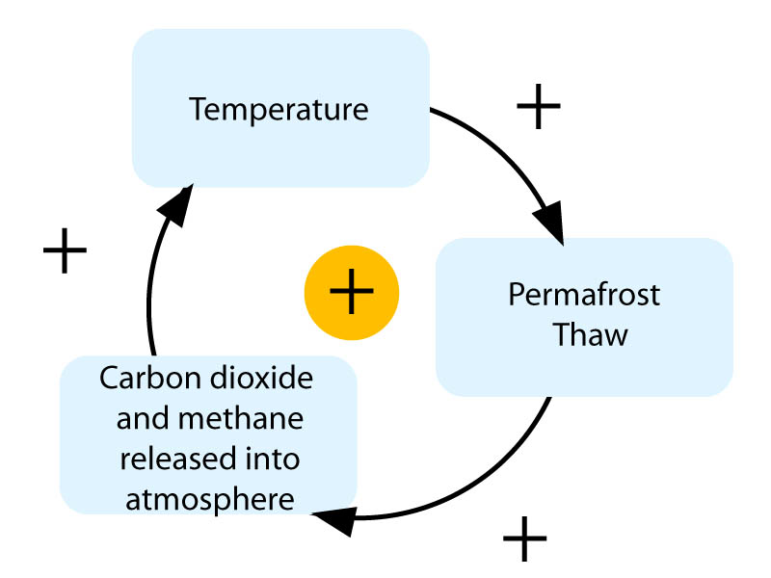
Feedback Mechanisms of Climate Change
Positive feedback: warming temperatures→ thawing permafrost→ methane released → increased temperatures

Slide 18
Feedback Mechanisms of Climate Change
Complete To Do page 336 in your notes
CANNOT pick “Clouds” since we already did that as a class
You are responsible for knowing and understanding 3 of these examples
Make sure you are able to fully explain these in detail

Slide 19
Fact or Fiction?
There has been significant debate due to conflicting EVSs surrounding the issue of climate change
Global climate models are complex and there is a degree of uncertainty regarding the accuracy of their predictions
Read page 327-328 “The Climate Change Debate”
How should we react when we have evidence that does not fit with an existing theory?

Slide 20
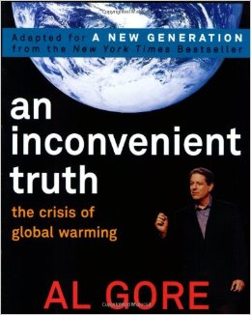
Fact or Fiction?

Slide 21
Classwork/Homework
Select and summarize two opposing views of global climate changes
Example: Michael Crichton vs Al Gore
Evaluate each and describe our reaction to it
Finally, present your own viewpoint
Page 338 – provides resources to help guide your research
If you haven’t already, take notes on all of Topic 7 and begin taking notes on Topic 8 next class!
Mr. G Science, ESS textbook, Ms. Simmons’ website

Slide 22
Carbon Dioxide Trends
Graph data for May and October
Year: X axis
CO2 emissions: Y axis
Make sure scale is appropriate for data
Make a key (two data sets: May and October)
Based on the data, predict CO2 concentrations for 2020. Put a star on the graph to represent that number on the graph

Slide 23
Carbon Dioxide Trends
Answer the following questions. Be prepared for a class discussion
What might account for differences in the CO2 concentrations measure in May and October of each year?
How could we take advantage of those natural periods of increased CO2 uptake to reduce overall CO2 in our atmosphere?
Based on the data shown on your graph, what do you think the CO2 concentration will be in the year 2020?
Why do you think carbon dioxide levels have continued to rise during the past 45 years?
What types of activities might raise CO2 levels even faster?
How do you think this will affect Earth’s climate? Predict how your life will be different if this climate change occurs.
What types of actions can we take to lower our CO2 emissions?

Slide 24
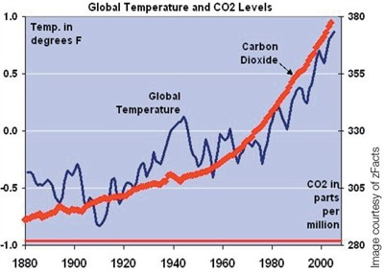
Temperature and CO₂ concentration from 1880 to present

Slide 25
7.3 Climate change – mitigation & adaptation

Slide 26
Possible Solutions
Reduce greenhouse gases by…
1. Don’t burn fossil fuels- Instead use renewable energy
(wind, solar, geothermal…)
2. Replanting forests – More trees = less CO₂ in atmosphere
3. Recycling – Reduces waste in landfills
4. Strict legislation and transportation laws
Carbon tax/carbon trading
Carpool lanes
Mass Transit
High Mileage standards

Slide 27
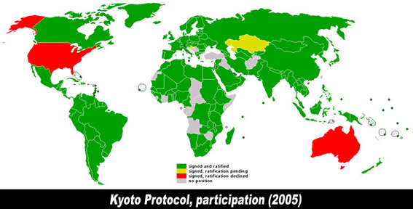
Global Solutions - Kyoto Protocol
1997, signed by 160 nations
Called for commitment to reduce greenhouse gas emissions 5.2% below 1990 levels before 2012
The US and Australia have not ratified the agreement

Slide 28
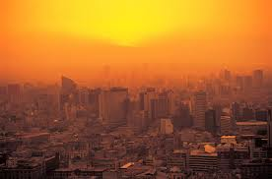
Complex Issue / Global Dimming
Climate models are predictions that are subject to high variability
Conflicting arguments exist about global warming being “real” or not.
Global dimming is the decreased amount of sunlight that will reach the earth due to increasing amounts of air pollution

Slide 29
Global Warming Investigation: Ecosystems & Countries
While reading your Ecosystem Role Cards as a group, answer the questions under The Effects of Climate Change on Living Things.
While reading the Climate Impact Projects & Regional Climate Summaries as a group, answer the Climate Prediction Sheet questions.
Be prepared to discuss/present the impacts described on your cards during class discussion.
EVERYONE MUST ANSWER QUESTIONS ON THEIR OWN SHEET BECAUSE MS. SIMMONS WILL CALL ON STUDENTS AT RANDOM! THERE IS NO SPOKESPERSON FOR THE GROUP NOR IS THERE A SCRIBE!
25-30 minutes

