Slide 1
North American Biomes

Slide 2
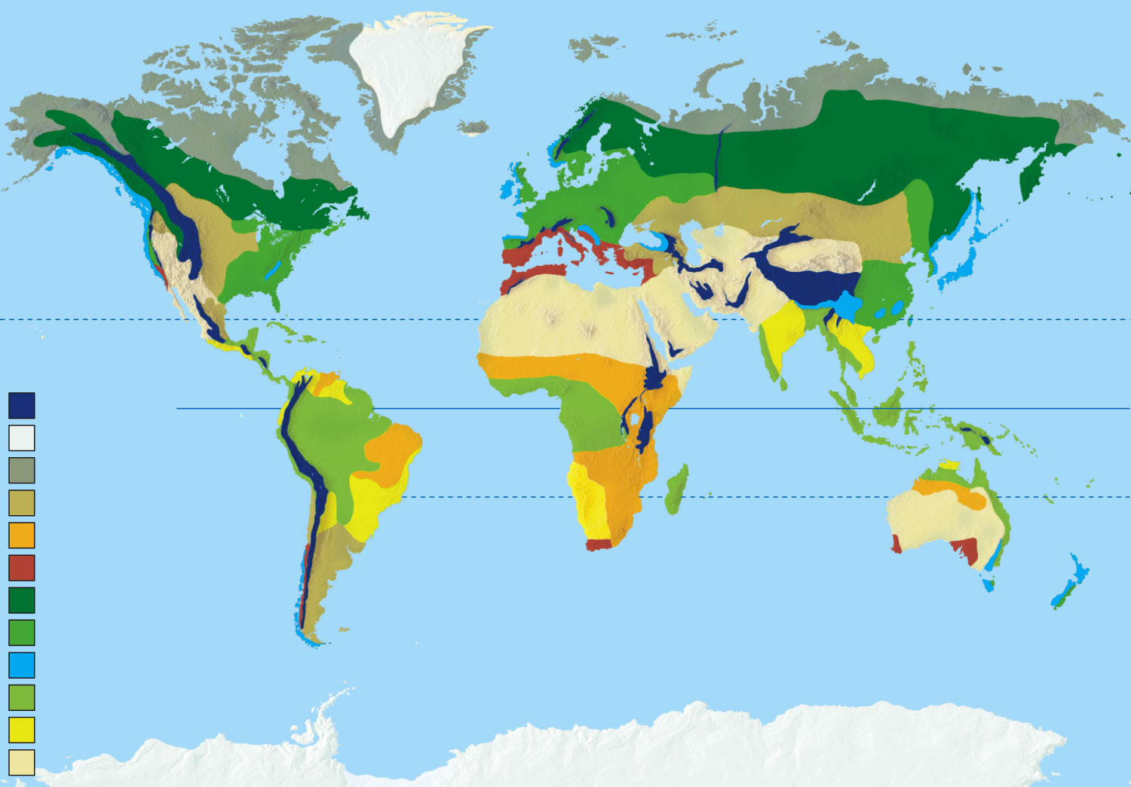
High mountains
Polar ice
Arctic tundra (cold grassland)
Temperate grassland
Tropical grassland (savanna)
Chaparral
Coniferous forest
Temperate deciduous forest
Temperate rain forest
Tropical rain forest
Tropical dry forest
Desert

Slide 3
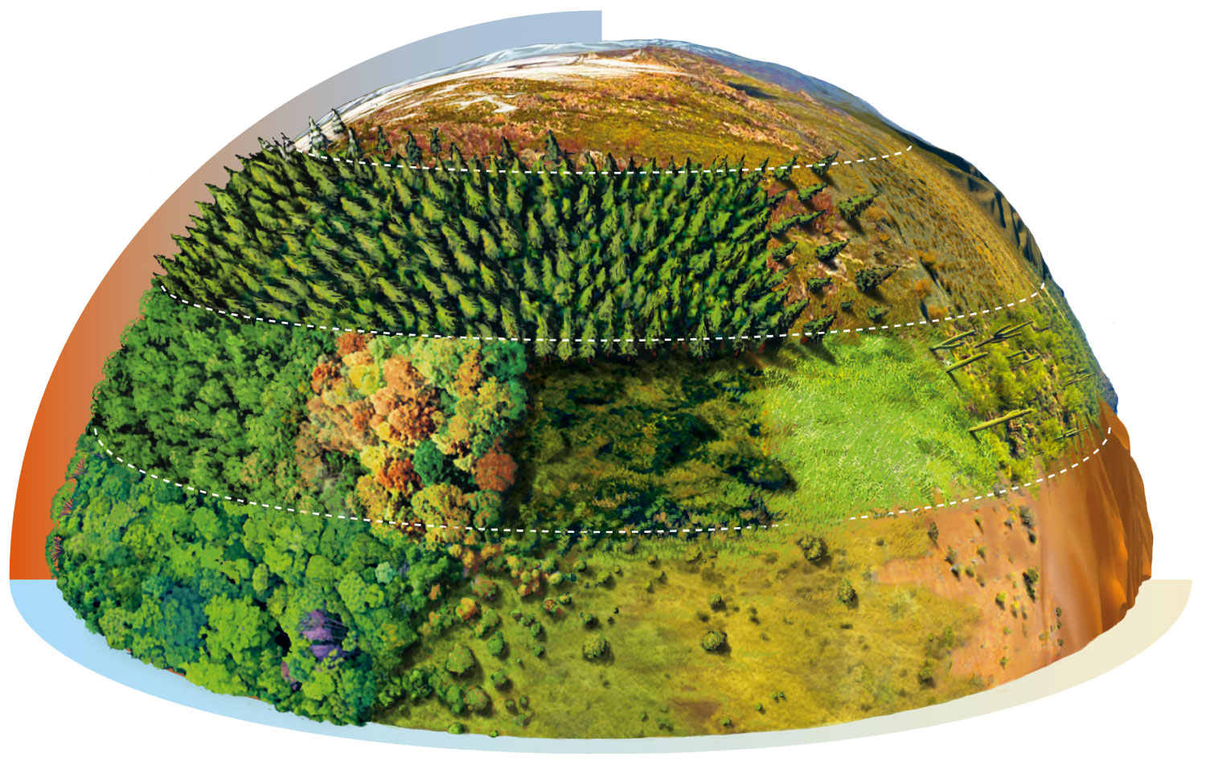
Cold
Arctic tundra
Evergreen coniferous forest
Cold desert
Temperate desert
Temperate deciduous forest
Temperate grassland
Chaparral
Hot Wet
Tropical desert
Tropical rain forest
Dry
Tropical grassland (savanna)

Slide 4
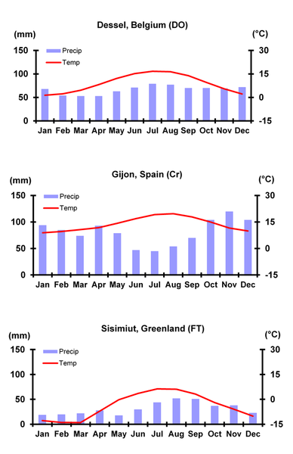
Climate Graphs/Climatographs
A graph showing the climate of a region over the course of a year
Bar graph shows precipitation
Line graph shows the temperature
https://www.youtube.com/watch?v=-iH-CZO1r2g

Slide 5
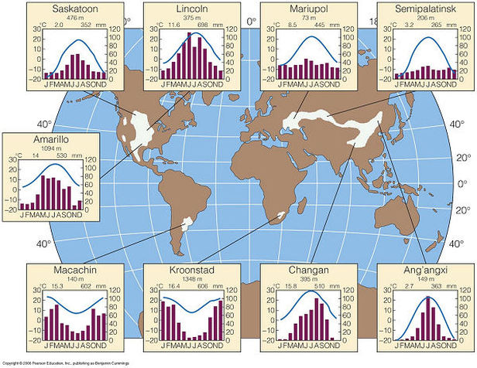

Slide 6
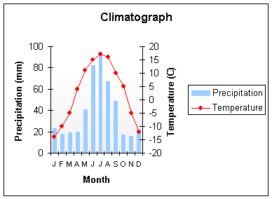
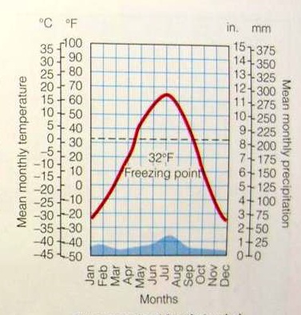
Climatograph Examples

Slide 7
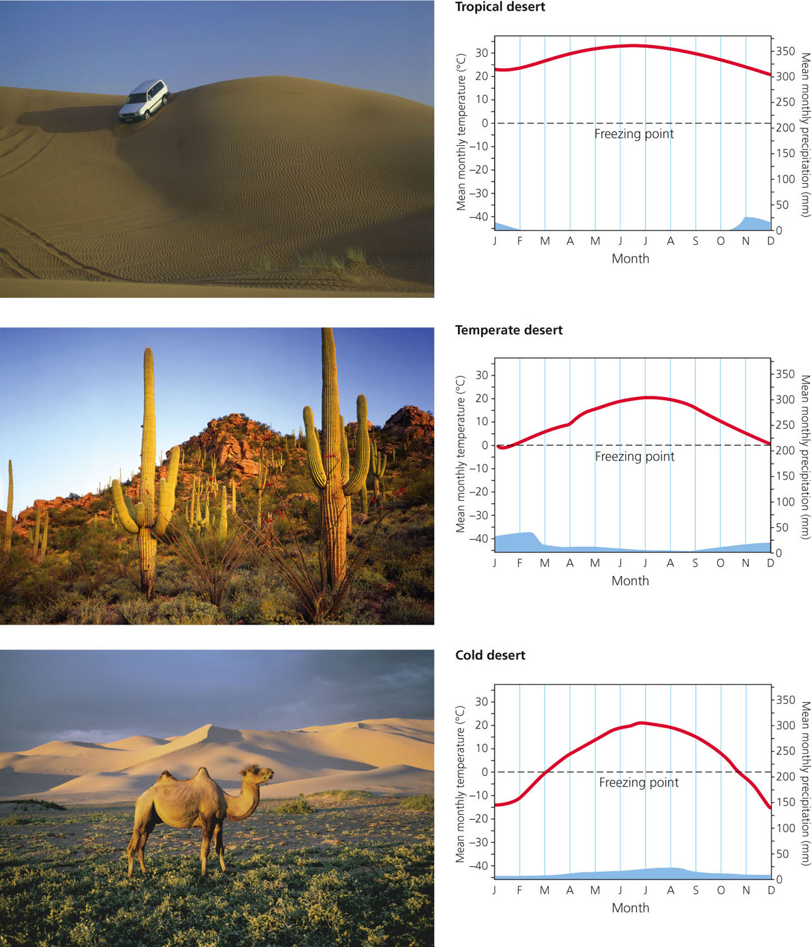

Slide 8
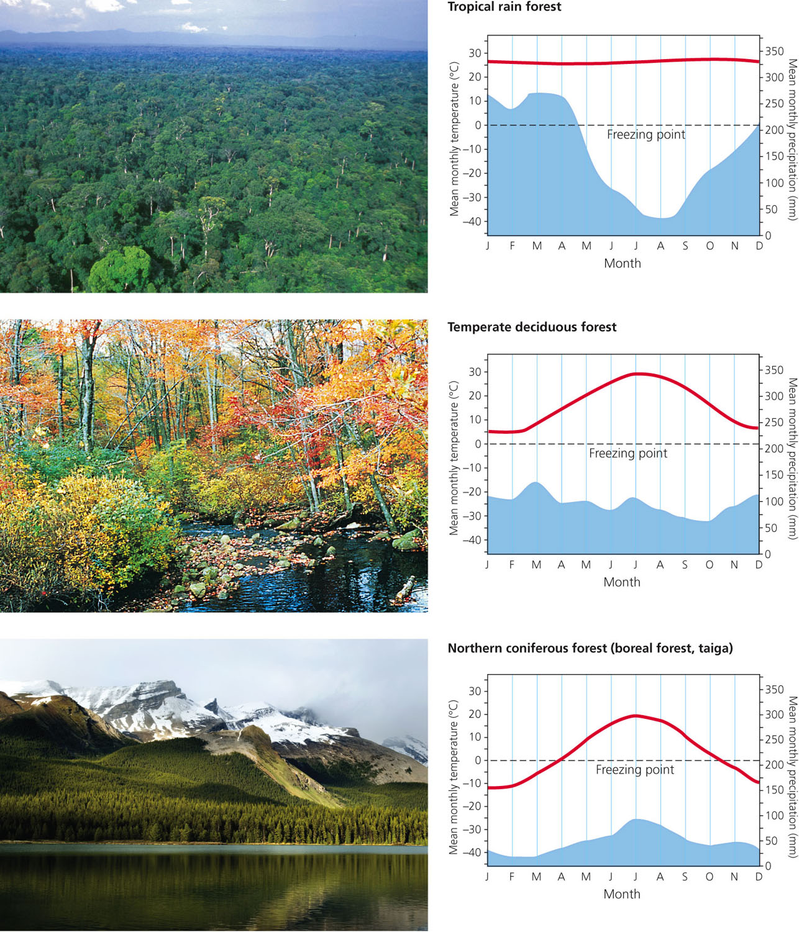

Slide 9
