Slide 1
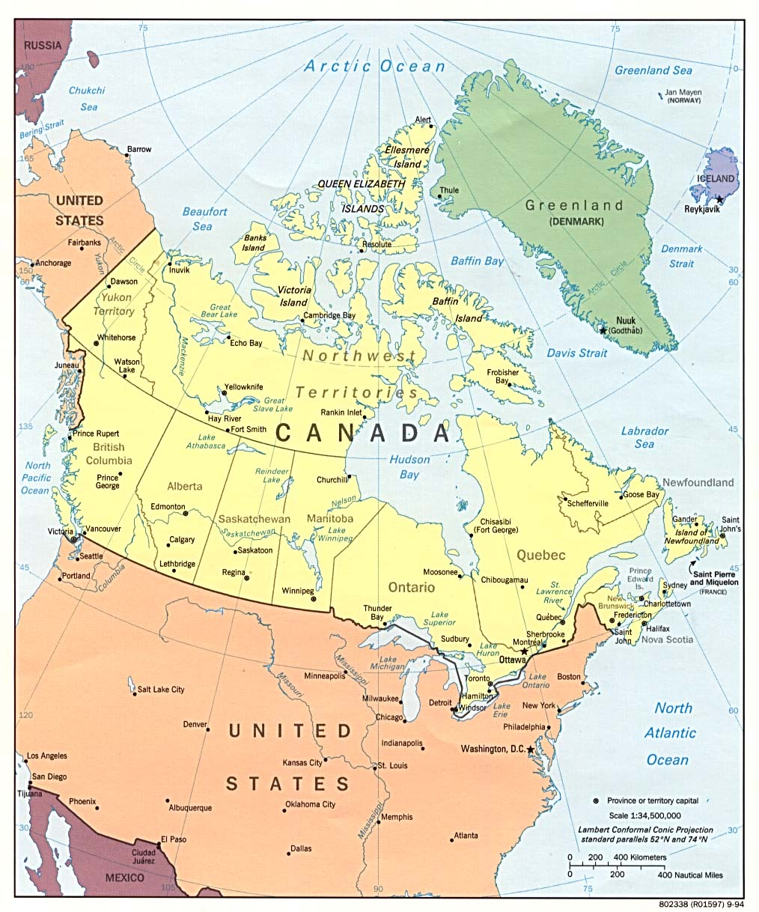
Do Now
What would happen if there were no border between the United States and Canada??
How is the cell membrane like a border between countries?
3. Think back to STERNGRR. What is regulation?

Slide 2
proteins
nervous
receptor
ANIMALS
plants
animals

Slide 3
proteins
lipids
certain
Type of lipid
2 layers
partial
access
lipids
proteins

Slide 4
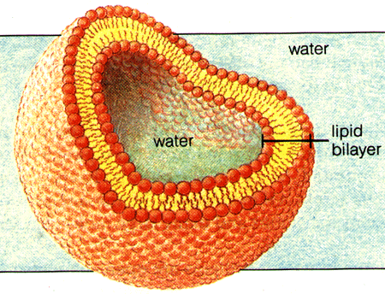

Slide 5
balance
pH
temperature
salt
constantly
in
out
difference
amount
molecules
cell
membrane
HOMEOSTASIS!!! Staying in check!

Slide 6
CFU Check For Understanding
“I don’t know” is NOT an acceptable response in this class!!
INSTEAD
What did you mean by…
How did you…
Why is it that…
Can you explain…
What are some other examples of…
What is the difference between…

Slide 7
Practice

Slide 8
enters
exits
transport
Particles
High to low
NO!
(PASSIVE)
high
NO!
(PASSIVE)
Water
low
NO!
(PASSIVE)
YES
Low to high
YES!
YES

Slide 9
Diffusion example

Slide 10
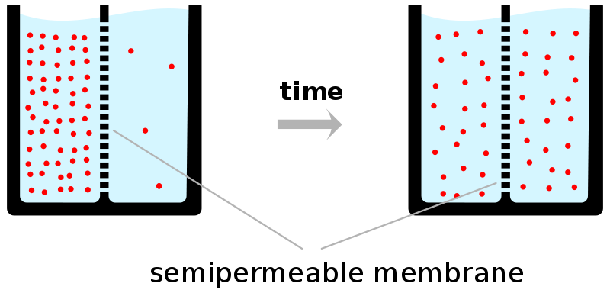
Diffusion example

Slide 11
Diffusion example

Slide 12
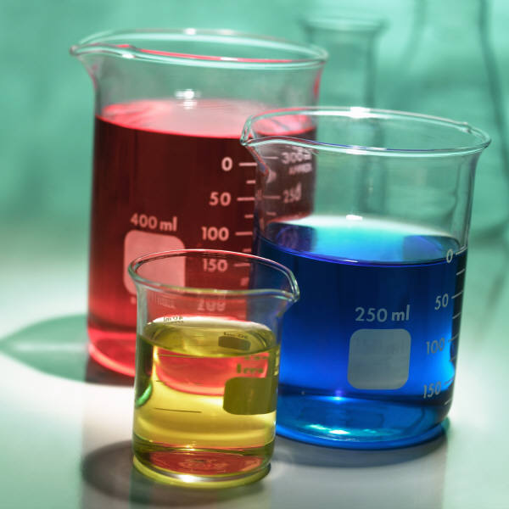
Let’s See Some Diffusion
http://www.youtube.com/watch?v=aVc_LEuiZ-4
http://www.stolaf.edu/people/giannini/flashanimat/transport/diffusion.swf
Food Coloring Demo
Febreeze Demo

Slide 13
CFU Check For Understanding
“I don’t know” is NOT an acceptable response in this class!!
INSTEAD
What did you mean by…
How did you…
Why is it that…
Can you explain…
What are some other examples of…
What is the difference between…

Slide 14
enters
exits
transport
Particles
High to low
NO!
(PASSIVE)
high
NO!
(PASSIVE)
Water
low
NO!
(PASSIVE)
YES
Low to high
YES!
YES

Slide 15
Osmosis Example

Slide 16
Osmosis Example
SALT
SUCKS!
SALT SUCKS!

Slide 17
Osmosis Example

Slide 18
Osmosis Example

Slide 19
Do Now
A cell has a concentration of 0.8% carbon dioxide gas and 0.4% oxygen gas. The blood surrounding the cell has an oxygen concentration of 1.2% and a carbon dioxide concentration of 0.1%. What will the cell lose? What will the cell gain? Draw a picture to demonstrate this transport.
2. A blood cell has the same concentration of water
and salt as saline solution. A doctor who failed high
school biology and did not listen to the attending
nurse used a injection full of distilled water (100%
water). What will happen to the blood cells
surrounded by the distilled water? (Hint: You will
feel excruciating pain.) Explain.

Slide 20
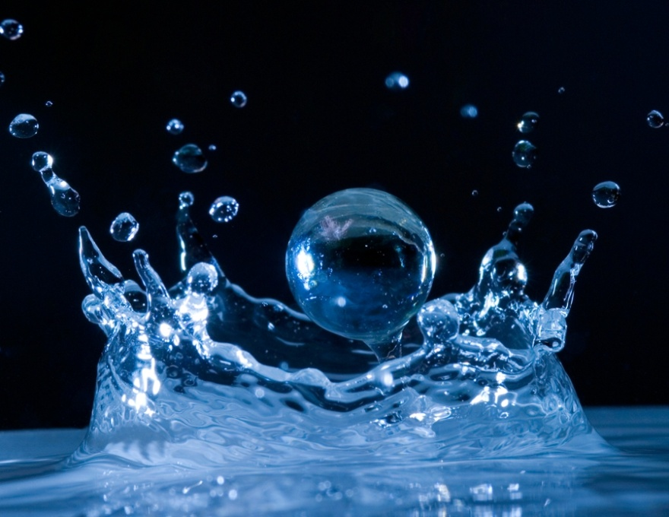
Let’s See Some Osmosis
http://www.stolaf.edu/people/giannini/flashanimat/transport/osmosis.swf

Slide 22
Practice!

Slide 23
Gummy Bear Lab

Slide 26
enters
exits
transport
Particles
High to low
NO!
(PASSIVE)
high
NO!
(PASSIVE)
Water
low
NO!
(PASSIVE)
YES
Low to high
YES!
YES

Slide 27
Facilitated Diffusion example

Slide 28
Facilitated Diffusion example

Slide 29
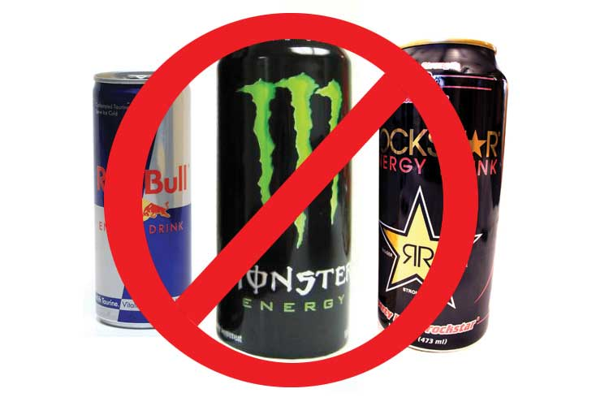
PASSIVE
ACTIVE
NO energy required
Energy required!

Slide 30
enters
exits
transport
Particles
High to low
NO!
(PASSIVE)
high
NO!
(PASSIVE)
Water
low
NO!
(PASSIVE)
YES
Low to high
YES!
YES

Slide 31
Active Transport Example

Slide 32
Active Transport Example

Slide 33
Practice!

Slide 34
Practice
Answer the Gummy Bear Lab questions on page U3-19
Complete practice problems on pages U3-14, U3-15 & U3-16
When all practice problems are complete, Ms. Simmons must check off your work

Slide 35
Do Now
Draw a picture to represent facilitated diffusion.
2. Define active transport.
3. What is the main difference between active and passive transport?
4. What are the 3 types of passive transport?

Slide 39
Do Now
Draw a picture of a mitochondria.
What is the function of the mitochondria?
Draw a picture of a chloroplast.
What is the function of the chloroplast?

