Slide 1
Worlds Most Polluted Places

Slide 2
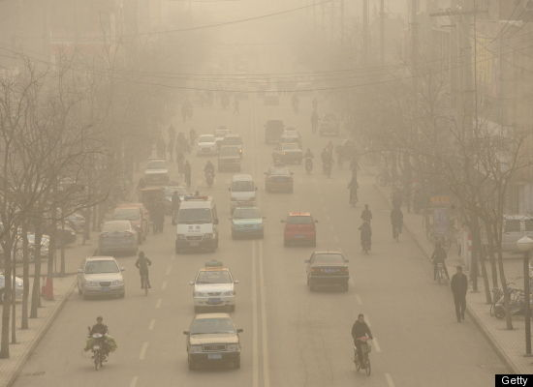
Linfen, China

Slide 3
Linfen, China
Linfen, China is the most polluted city on earth.
Laundry out to dry will turn black before finishing drying.
Located in China's coal belt
Spending one day in Linfen is equivalent to smoking three packs of cigarettes.
3 million people are affected by Linfen's coal and particulates pollution, which is residue from automobile and industrial emissions.

Slide 4
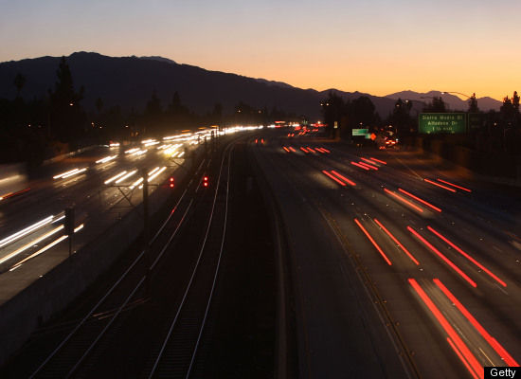
Los Angeles, CA

Slide 5
LA
Los Angeles is the city with the most ozone pollution in the United States.
In 2008, the average ozone level in Los Angeles was the worst of any American city
Air pollution causes 9,200 premature deaths per year in California.

Slide 6
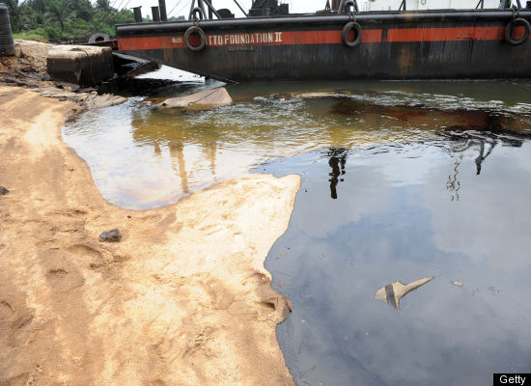
Niger Delta, Nigeria

Slide 7
Niger Delta, Nigeria
With more than 6,800 oil spills, which amounts to 300 spills a year, roughly one spill a day,
9 to 13 million barrels of oil spilled over 50 years, the Niger Delta remains one of the most oil-polluted locations on the planet.
Oil have been spilled into the third largest wetland on the planet.
Nigeria is the fifth largest supplier of oil to the United States.
Shell has stated that 90% of spills are caused by militant thieves who access the pipelines to steal oil. Watch CNN's coverage of the oil polluted Niger Delta.

Slide 8
Niger River Delta Oil Spills
http://www.cnn.com/2010/WORLD/africa/06/29/nigeria.oil/index.html?_sm_au_=iVV6SqN7ZZRrt77n

Slide 9
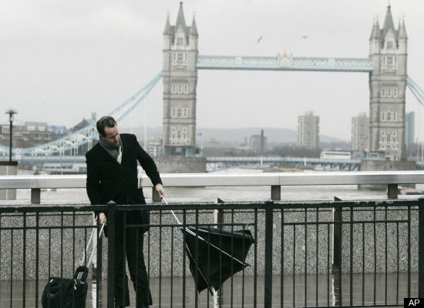
Greater London, UK

Slide 10
UK
Greater London has some of the worst air pollution worldwide as a result of car, factory, agriculture and house pollution.
The life expectancy of Britons has been reduced by nine years due to air pollution.
Europe's greatest releaser of nitrogen oxides, exposing 1.5 million people to unsafe quantities of the pollution.
50,000 people die prematurely each year due to man-made air pollution.

Slide 11
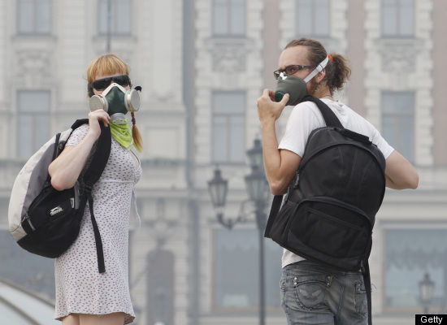
Dzerzhinsk, Russia

Slide 12
Dzerzhinsk, Russia
Dzerzhinsk was the dumping site for 300,000 tons of improperly disposed of chemical waste.
300,000 people are affected by the city's chemical and toxic byproduct pollution, such as sarin and VX gas.
The pollution is a result of Cold War-era manufacturing of chemical weapons.
In 2003, the city’s death rate surpassed its birth rate by 260 percent.

Slide 13
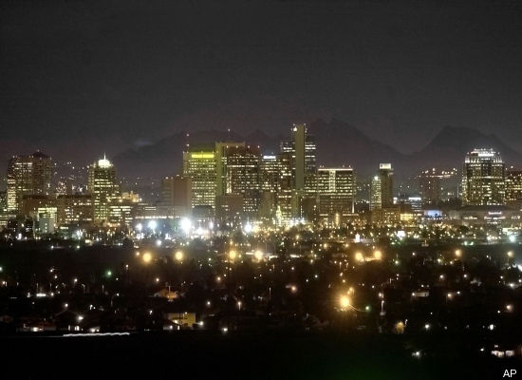
Greater Phoenix, AZ

Slide 14
Phoenix, AZ
The Phoenix-Mesa-Scottsdale area is 2010's worst place in the United States for year round particle pollution,
A mix of dust, soot and aerosols.
The Arizona region experiences year-round particle pollution at all hours of the day.

Slide 15
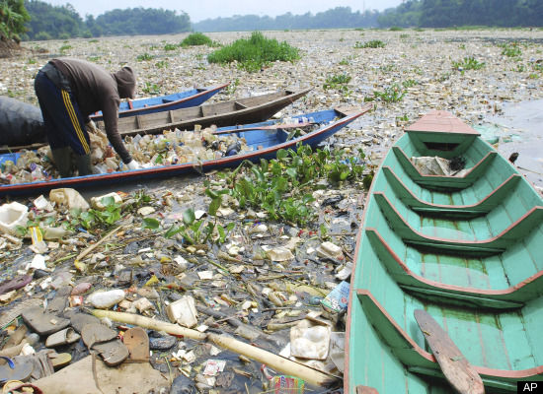
Bandung, Indonesia

Slide 16
Bandung, Indonesia
Indonesia hosts the most polluted river on the planet, the Citarum River.
With nearly 5 million residents living near the river, Citarum is a main water source
But 30 million rely on the river for drinking water, bathing, and agriculture

Slide 17
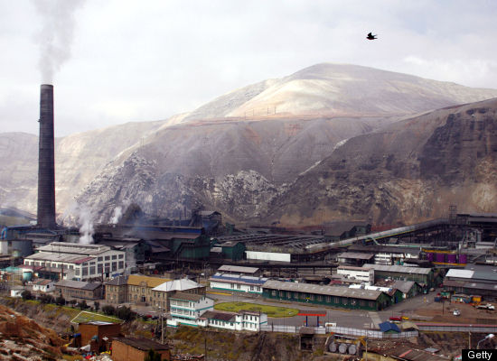
La Oroya, Peru

Slide 18
La Oroya, Peru
Metal mining and smelting has contaminated La Oroya, Peru.
Over 35,000 of La Oroya residents have been affected by lead, zinc, copper and sulfur dioxide pollution from the processing.
99 percent of the mining town's children have blood levels that surpass suitable limits of exposure.
Since 1922, the town in Peru's Andes Mountains has been polluted by mining missions.
The average lead level, according to a 1999 survery, was triple the WHO limit

Slide 19
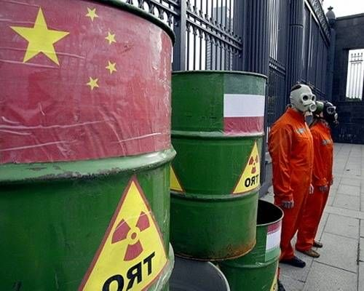
Lake Karachay, Russia

Slide 20
Lake Karachay, Russia
Lake Karachay region is considered to be the most polluted location on Planet Earth.
This Russian nuclear weapon production site turned Soviet Union nuclear dumping location has 120 million curies of radioactivity.
This radiation level is equivalent to a lethal dose after merely an hour.
The radiation has infiltrated the region's groundwater supply.

